Slide 1

Social Network Mining —Computational models for mining big social networks
Jie Tang
Tsinghua University
@Jan 2017

Slide 2

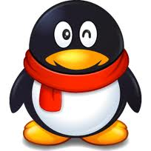

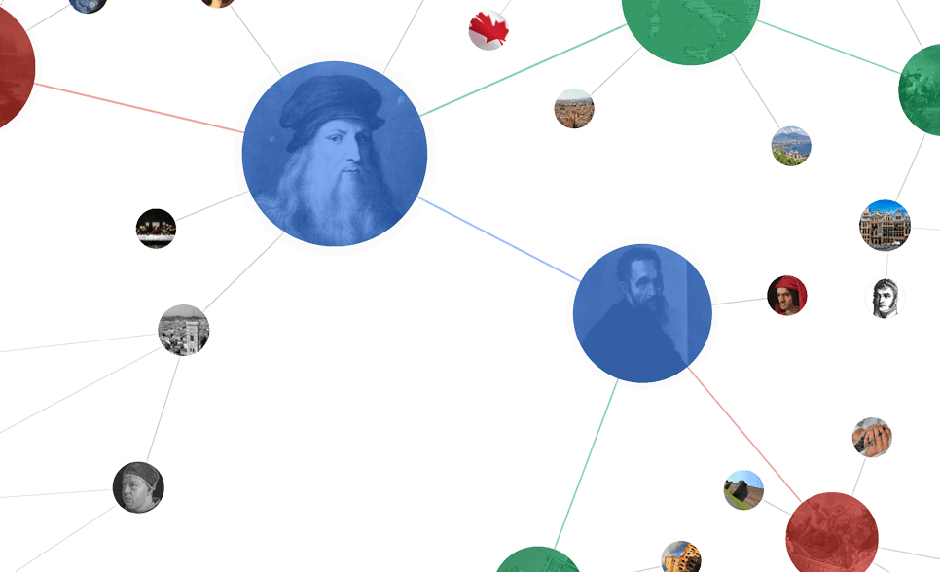




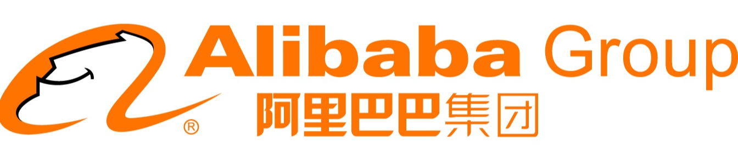
Networked World
1.65 billion MAU
2.5 trillion minutes/month
QQ: 800 million MAU
WeChat: 700 million MAU
255 million MAU
Peak: 143K tweets/s
220 million users
influencing our daily life
304 million active users
14 billion items/year
~700 million trans. (alipay)
120.7 billion on 11/11
Notes:
http://www.digitaltrends.com/social-media/facebook-users-50-minutes/#:Tt28J4FGJlT5fA

Slide 3
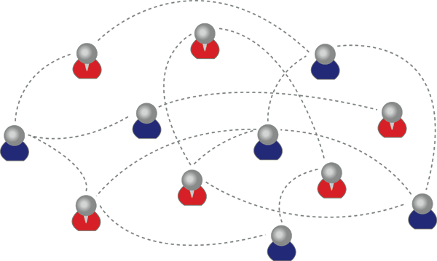
What is a social network?
A social network is:
a graph made up of :
a set of individuals, called “nodes”, and
tied by one or more interdependency, such as friendship, called “edges”.
Notes:
@CCDM 2016

Slide 4
So, that is Social Network?
To understand it, we need to trace back…

Slide 5

15-20 years before…
Web = Information Space
-
?
+
?
+
?
-
-
+
0.99
0.99
hyperlinks between web pages
Examples:
Google’s PageRank
Kleinberg’s HITS
0.80
… …
0.01
[1] L. Page, S. Brin, R. Motwani, & T. Winograd. (1999). The pagerank citation ranking: bringing order to the web. Stanford University.
[2] J. M. Kleinberg. Authoritative sources in a hyperlinked environment. Journal of the ACM (JACM) 46.5 (1999): 604-632.

Slide 6

10 years before…
Collaborative Web = Info Space + Users
Interaction
Personalized recommendation
Collaborative Filtering
[1] P. Resnick, N. Iacovou, M. Suchak, P. Bergstrom, & J. Riedl. (1994). GroupLens: an open architecture for collaborative filtering of netnews. CSCW'94. ACM, New York, NY, USA, 175-186.

Slide 7
Recent 5-10 years…
Social Network = Info. Space + Social Space
Info. Space
Information
Knowledge
Intelligence
Social Space
Interaction
[1] J. Scott. (1991, 2000, 2012). Social network analysis: A handbook.
[2] D. Easley and J. Kleinberg. Networks, crowds, and markets: Reasoning about a highly connected world. Cambridge University Press, 2010.

Slide 8
How about research for Social Network?
Computational Models
Big Data Algorithms
Sociology, Physics, Psychology, Business, Management, et al.
Interdisciplinary

Slide 9
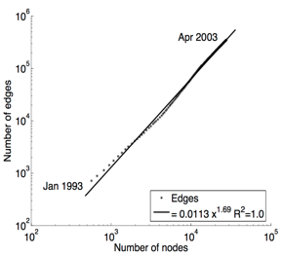
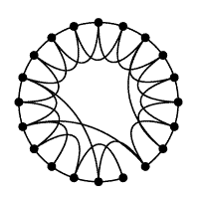
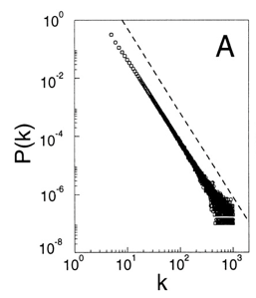
History of Social Network Analysis
Computational Social Science [Giles]
2012
Computational Social Science [Lazer et al.]
2009
2009-
2007
Spread of Obesity, Smoking, Happiness
[Christakis, Fowler]
2005
Densification [Leskovec, Kleinberg, Faloutsos]
2003
Link Prediction [Liben-Nowell, Kleinberg]
Influence Maximization [Kempe,Kleinberg,Tardos]
2002
Community Detection [Girvan, Newman]
Scale Free [Barabási,Albert & Faloutsos et al.]
1999
Small World [Watts, Strogatz]
1998
Hubs & Authorities [Kleinberg]
1997
1995
Structural Hole [Burt]
1992
Dunbar’s Number [Dunbar]
1973
Weak Tie [Granovetter]
1967
Six Degrees of Separation [Milgram]
Notes:
Social influence
Information diffusions
1955, Two step of flow: katz lazarsfeld

Slide 10
History of Social Network Analysis
Stanley Milgram. The small world problem. Psychology Today, 2(1):60–67, 1967.
1967: Six Degrees of Separation
“Given two individuals selected randomly from the population, what is the probability that the minimum number of intermediaries required to link them is 0, 1, 2, …, k?”
Milgram “selected 296 volunteers and to distribute a mail to a stockholder living in Boston.”
“The average number of intermediaries in the mailing chains was 5.2.”
Computational Social Science [Giles]
2012
Computational Social Science [Lazer et al.]
2009
Spread of Obesity, Smoking, Happiness
[Christakis, Fowler]
2008
2007
2005
Densification [Leskovec, Kleinberg, Faloutsos]
2003
Link Prediction [Liben-Nowell, Kleinberg]
Influence Maximization [Kempe,Kleinberg,Tardos]
2002
Community Detection [Girvan, Newman]
Scale Free [Barabási,Albert & Faloutsos et al.]
1999
Small World [Watts, Strogatz]
1998
Hubs & Authorities [Kleinberg]
1997
Stanley Milgram. The small world problem. Psychology Today, 2(1):60–67, 1967. Cited by 6967 (as of May 2016)
1995
Structural Hole [Burt]
1992
Dunbar’s Number [Dunbar]
1973
Weak Tie [Granovetter]
1967
Six Degrees of Separation [Milgram]
Notes:
Social influence
Information diffusions
1955, Two step of flow: katz lazarsfeld

Slide 11
History of Social Network Analysis
Stanley Milgram. The small world problem. Psychology Today, 2(1):60–67, 1967.
1992: Dunbar’s Number
“Dunbar‘s number is a suggested cognitive limit to the number of people with whom one can maintain stable social relationships.”
Dunbar “proposed that humans can only comfortably maintain 150 stable relationships.”
Computational Social Science [Giles]
2012
Computational Social Science [Lazer et al.]
2009
Spread of Obesity, Smoking, Happiness
[Christakis, Fowler]
2008
2007
2005
Densification [Leskovec, Kleinberg, Faloutsos]
2003
Link Prediction [Liben-Nowell, Kleinberg]
Influence Maximization [Kempe,Kleinberg,Tardos]
2002
Community Detection [Girvan, Newman]
Scale Free [Barabási,Albert & Faloutsos et al.]
1999
Small World [Watts, Strogatz]
1998
Robin I. M. Dunbar. Neocortex size as a constraint on group size in primates. Journal of Human Evolution 22 (6): 469–493. Cited by 1393 (as of May 2016)
Hubs & Authorities [Kleinberg]
1997
1995
Structural Hole [Burt]
1992
Dunbar’s Number [Dunbar]
1973
Weak Tie [Granovetter]
1967
Six Degrees of Separation [Milgram]
Notes:
Social influence
Information diffusions
1955, Two step of flow: katz lazarsfeld

Slide 12
History of Social Network Analysis
Stanley Milgram. The small world problem. Psychology Today, 2(1):60–67, 1967.
1995: Structural Holes
“The position of a bridge between distinct groups allows him or her to transfer valuable information from one group to another.”
“The individual can combine all the ideas he or she receives from different sources and come up with the most innovative idea among all.”
Computational Social Science [Giles]
2012
Computational Social Science [Lazer et al.]
2009
Spread of Obesity, Smoking, Happiness
[Christakis, Fowler]
2008
2007
2005
Densification [Leskovec, Kleinberg, Faloutsos]
2003
Link Prediction [Liben-Nowell, Kleinberg]
Influence Maximization [Kempe,Kleinberg,Tardos]
2002
Community Detection [Girvan, Newman]
Scale Free [Barabási,Albert & Faloutsos et al.]
1999
Small World [Watts, Strogatz]
1998
Ronald S. Burt. Structural Holes: The Social Structure of Competition. Cambridge: Harvard University Press. 1995. Cited by 20207 (as of May 2016)
Hubs & Authorities [Kleinberg]
1997
1995
Structural Hole [Burt]
1992
Dunbar’s Number [Dunbar]
1973
Weak Tie [Granovetter]
1967
Six Degrees of Separation [Milgram]
Notes:
Social influence
Information diffusions
1955, Two step of flow: katz lazarsfeld

Slide 13
History of Social Network Analysis
Stanley Milgram. The small world problem. Psychology Today, 2(1):60–67, 1967.
Computational Social Science [Giles]
2012
The 20th Century:
Sociology & Anthropology
Computational Social Science [Lazer et al.]
2009
Spread of Obesity, Smoking, Happiness
[Christakis, Fowler]
2008
2007
2005
Densification [Leskovec, Kleinberg, Faloutsos]
2003
Link Prediction [Liben-Nowell, Kleinberg]
Influence Maximization [Kempe,Kleinberg,Tardos]
2002
Community Detection [Girvan, Newman]
Scale Free [Barabási,Albert & Faloutsos et al.]
1999
Small World [Watts, Strogatz]
1998
Hubs & Authorities [Kleinberg]
1997
1995
Structural Hole [Burt]
1992
Dunbar’s Number [Dunbar]
1973
Weak Tie [Granovetter]
1967
Six Degrees of Separation [Milgram]
Notes:
Social influence
Information diffusions
1955, Two step of flow: katz lazarsfeld

Slide 14
History of Social Network Analysis
Stanley Milgram. The small world problem. Psychology Today, 2(1):60–67, 1967.
1997-1998: HITS and PageRank
Computational Social Science [Giles]
2012
Computational Social Science [Lazer et al.]
2009
Spread of Obesity, Smoking, Happiness
[Christakis, Fowler]
2008
2007
2005
Densification [Leskovec, Kleinberg, Faloutsos]
2003
Link Prediction [Liben-Nowell, Kleinberg]
Influence Maximization [Kempe,Kleinberg,Tardos]
2002
Community Detection [Girvan, Newman]
Scale Free [Barabási,Albert & Faloutsos et al.]
1999
Small World [Watts, Strogatz]
1998
Hubs & Authorities [Kleinberg]
1997
Stanley Milgram. The small world problem. Psychology Today, 2(1):60–67, 1967.
1995
Structural Hole [Burt]
1. Jon M. Kleinberg. Authoritative sources in a hyperlinked environment. In ACM SODA, 1998. Extended version in Journal of the ACM 46 (1999). Also at IBM Research Report RJ 10076, May 1997. Cited by 9896 (as of May 2016)
2. Sergey Brin, Lawrence Page. The anatomy of a large-scale hypertextual Web search engine. In WWW’07, Pages 107-117,1998. Cited by 14618 (as of May 2016)
1992
Dunbar’s Number [Dunbar]
1973
Weak Tie [Granovetter]
1967
Six Degrees of Separation [Milgram]
Notes:
Social influence
Information diffusions
1955, Two step of flow: katz lazarsfeld

Slide 15
History of Social Network Analysis
Stanley Milgram. The small world problem. Psychology Today, 2(1):60–67, 1967.
1998: Small World
Computational Social Science [Giles]
2012
Small-World Properties:
1. short average path lengths
2. high clustering coefficients
Computational Social Science [Lazer et al.]
2009
Spread of Obesity, Smoking, Happiness
[Christakis, Fowler]
2008
2007
2005
Densification [Leskovec, Kleinberg, Faloutsos]
2003
Link Prediction [Liben-Nowell, Kleinberg]
Influence Maximization [Kempe,Kleinberg,Tardos]
2002
Community Detection [Girvan, Newman]
Scale Free [Barabási,Albert & Faloutsos et al.]
1999
Small World [Watts, Strogatz]
1998
Hubs & Authorities [Kleinberg]
1997
Stanley Milgram. The small world problem. Psychology Today, 2(1):60–67, 1967.
1995
Structural Hole [Burt]
Duncan Watts, Steven Strogatz. Collective dynamics of ‘small-world’ networks. Nature 393 (6684): 440–442. Cited by 29044 (as of May 2016)
1992
Dunbar’s Number [Dunbar]
1973
Weak Tie [Granovetter]
1967
Six Degrees of Separation [Milgram]
Notes:
Social influence
Information diffusions
1955, Two step of flow: katz lazarsfeld

Slide 16
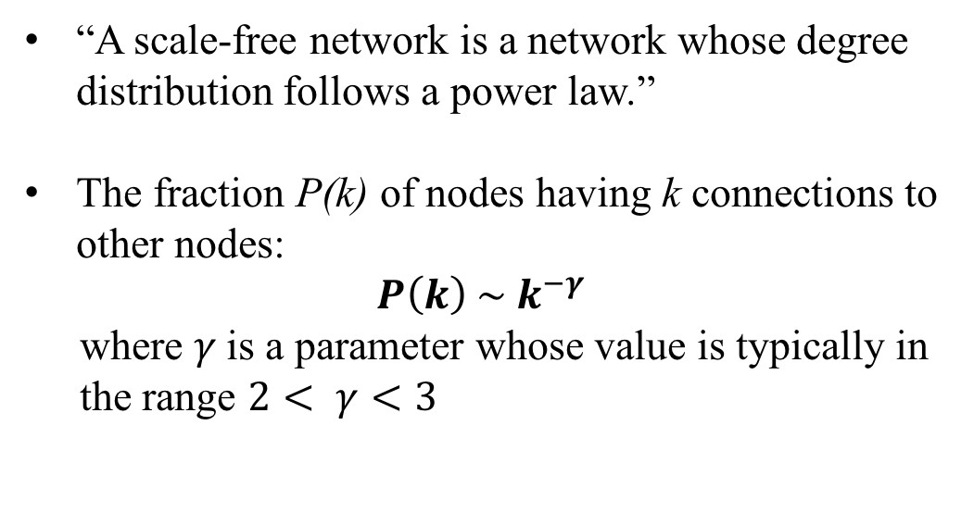
History of Social Network Analysis
Stanley Milgram. The small world problem. Psychology Today, 2(1):60–67, 1967.
1999: Scale Free
“A scale-free network is a network whose degree distribution follows a power law.”
The fraction P(k) of nodes having k connections to other nodes:
$$P\left(k\right) \sim k^{−γ}$$
where $γ$is a parameter whose value is typically in the range $2< γ<3$
Computational Social Science [Giles]
2012
Computational Social Science [Lazer et al.]
2009
Spread of Obesity, Smoking, Happiness
[Christakis, Fowler]
2008
2007
2005
Densification [Leskovec, Kleinberg, Faloutsos]
2003
Link Prediction [Liben-Nowell, Kleinberg]
Influence Maximization [Kempe,Kleinberg,Tardos]
2002
Community Detection [Girvan, Newman]
Scale Free [Barabási,Albert & Faloutsos et al.]
1999
Small World [Watts, Strogatz]
1998
Hubs & Authorities [Kleinberg]
1997
Stanley Milgram. The small world problem. Psychology Today, 2(1):60–67, 1967.
1995
Structural Hole [Burt]
Albert-László Barabási, Réka Albert. Emergence of scaling in random networks, Science, 286:509–512, 1999. Cited by 25189 (as of May 2016)
Michalis Faloutsos, Petros Faloutsos, Christos Faloutsos. On power-law relationships of the internet topology. In ACM SIGCOMM 1999. Cited by 5631 (as of May 2016)
1992
Dunbar’s Number [Dunbar]
1973
Weak Tie [Granovetter]
1967
Six Degrees of Separation [Milgram]
Notes:
Social influence
Information diffusions
1955, Two step of flow: katz lazarsfeld

Slide 17
History of Social Network Analysis
Stanley Milgram. The small world problem. Psychology Today, 2(1):60–67, 1967.
The Late 20th Century:
Computer Science & Physics & Mathematics
Computational Social Science [Giles]
2012
Computational Social Science [Lazer et al.]
2009
Spread of Obesity, Smoking, Happiness
[Christakis, Fowler]
2008
2007
2005
Densification [Leskovec, Kleinberg, Faloutsos]
2003
Link Prediction [Liben-Nowell, Kleinberg]
Influence Maximization [Kempe,Kleinberg,Tardos]
2002
Community Detection [Girvan, Newman]
Scale Free [Barabási,Albert & Faloutsos et al.]
1999
Small World [Watts, Strogatz]
1998
Hubs & Authorities [Kleinberg]
1997
1995
Structural Hole [Burt]
1992
Dunbar’s Number [Dunbar]
1973
Weak Tie [Granovetter]
1967
Six Degrees of Separation [Milgram]
Stanley Milgram. The small world problem. Psychology Today, 2(1):60–67, 1967.
The 20th Century: Sociology & Anthropology
Notes:
Social influence
Information diffusions
1955, Two step of flow: katz lazarsfeld

Slide 18
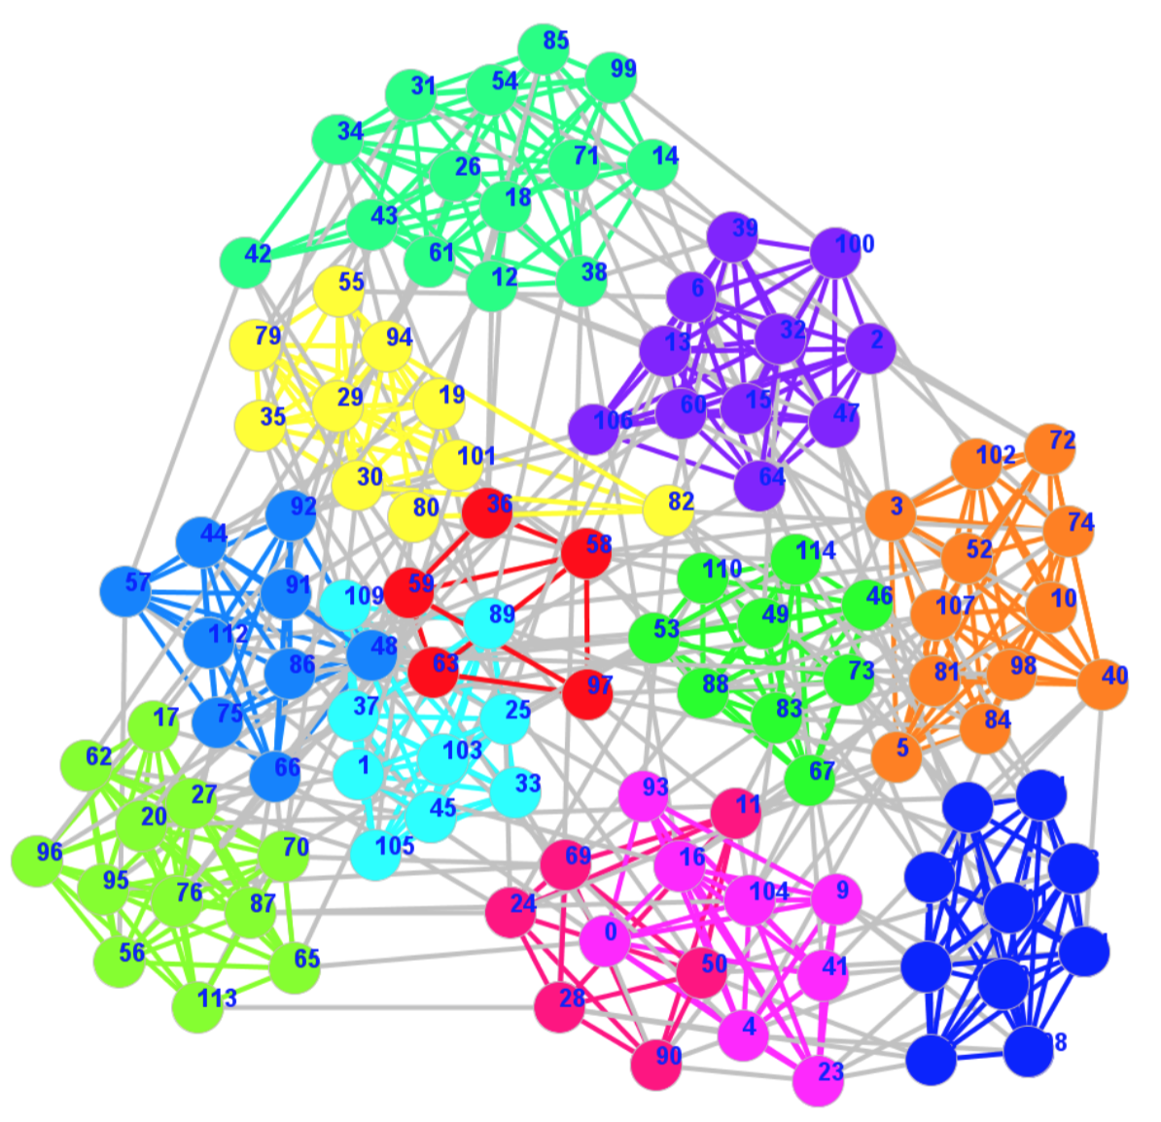
History of Social Network Analysis
Stanley Milgram. The small world problem. Psychology Today, 2(1):60–67, 1967.
2002: Community Detection
“The property of community structure, in which network nodes are joined together in tightly knit groups, between which there are only looser connections.”
Computational Social Science [Giles]
2012
M. Girvan and M. E. J. Newman. Community structure in social and biological networks. PNAS 99(12):7821-7826, 2002. Cited by 8088 (as of May 2016)
Computational Social Science [Lazer et al.]
2009
2009-
2007
Spread of Obesity, Smoking, Happiness
[Christakis, Fowler]
2005
Evolution [Leskovec, Kleinberg, Faloutsos]
2003
Link Prediction [Liben-Nowell, Kleinberg]
Influence Maximization [Kempe,Kleinberg,Tardos]
2002
Community Detection [Girvan, Newman]
Stanley Milgram. The small world problem. Psychology Today, 2(1):60–67, 1967.
Scale Free [Barabási,Albert & Faloutsos et al.]
1999
Small World [Watts, Strogatz]
1998
Hubs & Authorities [Kleinberg]
1997
1995
Structural Hole [Burt]
1992
Dunbar’s Number [Dunbar]
1973
Weak Tie [Granovetter]
1967
Six Degrees of Separation [Milgram]
Notes:
Social influence
Information diffusions
1955, Two step of flow: katz lazarsfeld

Slide 19
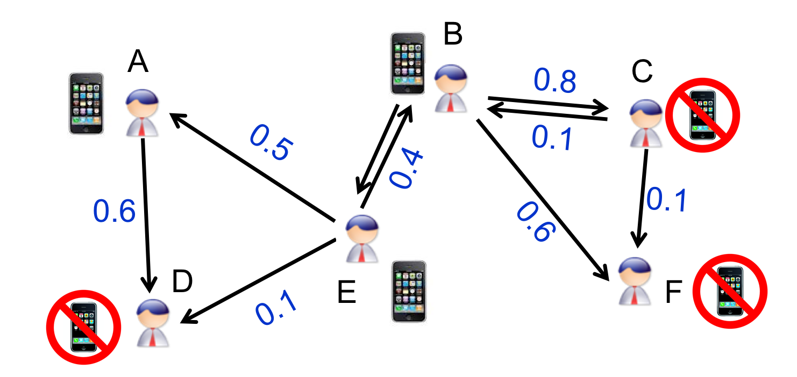
History of Social Network Analysis
2003: Influence Maximization
Minimize marketing cost and more generally to maximize profit, e.g., to get a small number of influential users to adopt a new product, and subsequently trigger a large cascade of further adoptions.
Computational Social Science [Giles]
2012
D. Kempe, J. Kleinberg, E. Tardos. Maximizing the Spread of Influence through a Social Network. In ACM KDD 2003. Best Research Paper Award & Test of Time Paper Award. Cited by 3513 (as of May 2016)
Computational Social Science [Lazer et al.]
2009
2009-
2007
Spread of Obesity, Smoking, Happiness
[Christakis, Fowler]
2005
Evolution [Leskovec, Kleinberg, Faloutsos]
2003
Link Prediction [Liben-Nowell, Kleinberg]
Influence Maximization [Kempe,Kleinberg,Tardos]
2002
Community Detection [Girvan, Newman]
Stanley Milgram. The small world problem. Psychology Today, 2(1):60–67, 1967.
Scale Free [Barabási,Albert & Faloutsos et al.]
1999
Small World [Watts, Strogatz]
1998
Hubs & Authorities [Kleinberg]
1997
1995
Structural Hole [Burt]
1992
Dunbar’s Number [Dunbar]
1973
Weak Tie [Granovetter]
1967
Six Degrees of Separation [Milgram]
Notes:
Social influence
Information diffusions
1955, Two step of flow: katz lazarsfeld

Slide 20
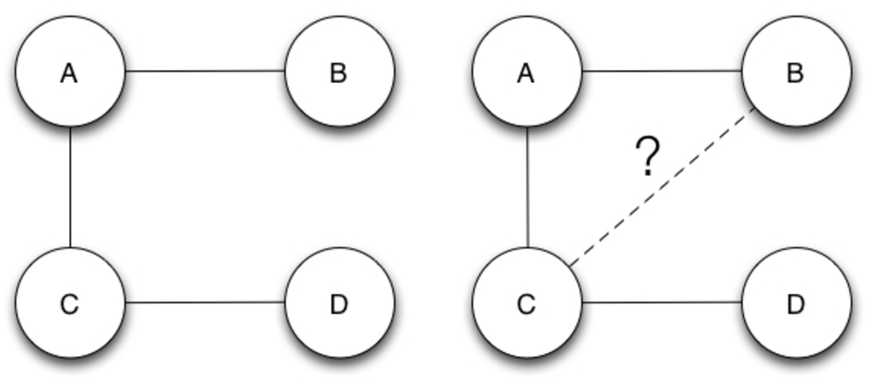
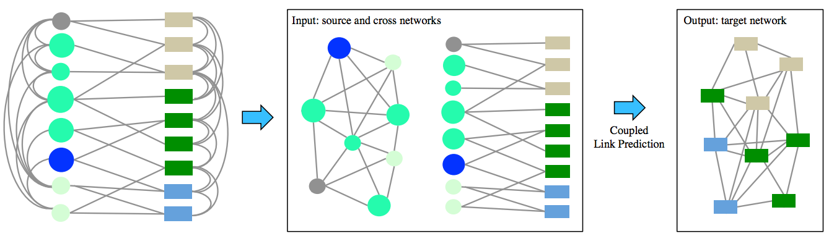
History of Social Network Analysis
Stanley Milgram. The small world problem. Psychology Today, 2(1):60–67, 1967.
2003: Link Prediction
“Given a snapshot of a social network at time t, we seek to accurately predict the edges that will be added to the network during the interval from time t to a given future time t’ .”
Computational Social Science [Giles]
2012
Computational Social Science [Lazer et al.]
2009
D. Liben-Nowell, J. Kleinberg. The Link Prediction Problem for Social Networks. In ACM CIKM, 2003. Cited by 2616 (as of May 2016)
2009-
2007
Spread of Obesity, Smoking, Happiness
[Christakis, Fowler]
2005
Evolution [Leskovec, Kleinberg, Faloutsos]
2003
Link Prediction [Liben-Nowell, Kleinberg]
Influence Maximization [Kempe,Kleinberg,Tardos]
2002
Community Detection [Girvan, Newman]
Stanley Milgram. The small world problem. Psychology Today, 2(1):60–67, 1967.
Scale Free [Barabási,Albert & Faloutsos et al.]
1999
Small World [Watts, Strogatz]
1998
Hubs & Authorities [Kleinberg]
1997
1995
Structural Hole [Burt]
1992
Dunbar’s Number [Dunbar]
t
t’
1973
Weak Tie [Granovetter]
1967
Six Degrees of Separation [Milgram]
Notes:
Social influence
Information diffusions
1955, Two step of flow: katz lazarsfeld

Slide 21
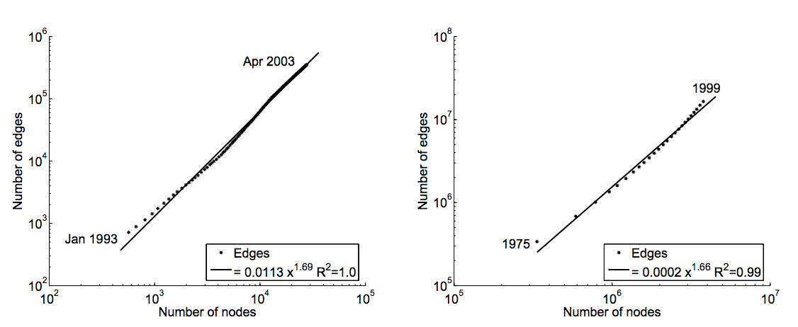
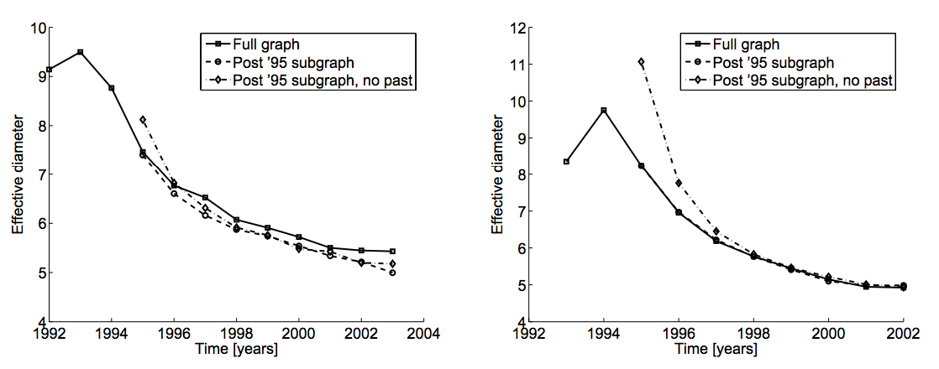
History of Social Network Analysis
Stanley Milgram. The small world problem. Psychology Today, 2(1):60–67, 1967.
2005: Network Evolution
“Most of graphs densify over time, with the number of edges growing superlinearly in the number of nodes.”
“The average distance between nodes often shrinks over time.”
Computational Social Science [Giles]
2012
Computational Social Science [Lazer et al.]
2009
J. Leskovec, J. Kleinberg, C. Faloutsos. Graphs over Time: Densification Laws, Shrinking Diameters and Possible Explanations. In ACM KDD, 2005. Best Research Paper Award. Cited by 1492 (as of May 2016)
2009-
2007
Spread of Obesity, Smoking, Happiness
[Christakis, Fowler]
2005
Evolution [Leskovec, Kleinberg, Faloutsos]
2003
Link Prediction [Liben-Nowell, Kleinberg]
Influence Maximization [Kempe,Kleinberg,Tardos]
2002
Community Detection [Girvan, Newman]
Stanley Milgram. The small world problem. Psychology Today, 2(1):60–67, 1967.
Scale Free [Barabási,Albert & Faloutsos et al.]
1999
Small World [Watts, Strogatz]
1998
Hubs & Authorities [Kleinberg]
1997
1995
Structural Hole [Burt]
1992
Dunbar’s Number [Dunbar]
Densification
1973
Weak Tie [Granovetter]
Shrinking Diameters
1967
Six Degrees of Separation [Milgram]
Notes:
Social influence
Information diffusions
1955, Two step of flow: katz lazarsfeld

Slide 22
History of Social Network Analysis
Stanley Milgram. The small world problem. Psychology Today, 2(1):60–67, 1967.
2007: Diffusion and Influence
Nicholas Christakis, James Fowler. The Spread of Obesity in a Large Social Network Over 32 Years. The New England Journal of Medicine 357 (4): 370–379, 2007. Cited by 3335 (as of May 2016)
Nicholas Christakis, James Fowler. The Collective Dynamics of Smoking in a Large Social Network. The New England Journal of Medicine 358 (21): 2249–2258, 2008. Cited by 1232 (as of May 2016)
James Fowler, Nicholas Christakis. The Dynamic Spread of Happiness in a Large Social Network. British Medical Journal 337 (768): a2338, 2009. Cited by 1178 (as of May 2016)
Computational Social Science [Giles]
2012
Computational Social Science [Lazer et al.]
2009
2009-
2007
Spread of Obesity, Smoking, Happiness
[Christakis, Fowler]
2005
Densification [Leskovec, Kleinberg, Faloutsos]
2003
Link Prediction [Liben-Nowell, Kleinberg]
Influence Maximization [Kempe,Kleinberg,Tardos]
2002
Community Detection [Girvan, Newman]
Stanley Milgram. The small world problem. Psychology Today, 2(1):60–67, 1967.
Scale Free [Barabási,Albert & Faloutsos et al.]
1999
“If the husband became obese, the likelihood that his wife would become obese increased by 37%.”
—by tracking 10,000+ people for 32 years
Small World [Watts, Strogatz]
1998
Hubs & Authorities [Kleinberg]
1997
1995
Structural Hole [Burt]
1992
Dunbar’s Number [Dunbar]
1973
Weak Tie [Granovetter]
1967
Six Degrees of Separation [Milgram]
Notes:
Social influence
Information diffusions
1955, Two step of flow: katz lazarsfeld

Slide 23
History of Social Network Analysis
Stanley Milgram. The small world problem. Psychology Today, 2(1):60–67, 1967.
The Early 21st Century
More Computer & Data Scientists
Computational Social Science [Giles]
2012
Computational Social Science [Lazer et al.]
2009
2009-
2007
Spread of Obesity, Smoking, Happiness
[Christakis, Fowler]
2005
Densification [Leskovec, Kleinberg, Faloutsos]
2003
Link Prediction [Liben-Nowell, Kleinberg]
Influence Maximization [Kempe,Kleinberg,Tardos]
2002
Community Detection [Girvan, Newman]
Scale Free [Barabási,Albert & Faloutsos et al.]
1999
Small World [Watts, Strogatz]
1998
Hubs & Authorities [Kleinberg]
1997
1995
Structural Hole [Burt]
1992
Dunbar’s Number [Dunbar]
1973
Weak Tie [Granovetter]
1967
Six Degrees of Separation [Milgram]
The Late 20th Century:
Computer Science & Physics & Mathematics
The 20th Century: Sociology & Anthropology
Notes:
Social influence
Information diffusions
1955, Two step of flow: katz lazarsfeld

Slide 24
Computational Social Science
Computational Social Science [Giles]
2012
Computational Social Science [Lazer et al.]
2009
2009-
2007
Spread of Obesity, Smoking, Happiness
[Christakis, Fowler]
2005
Densification [Leskovec, Kleinberg, Faloutsos]
2003
Link Prediction [Liben-Nowell, Kleinberg]
Influence Maximization [Kempe,Kleinberg,Tardos]
2002
Community Detection [Girvan, Newman]
Scale Free [Barabási,Albert & Faloutsos et al.]
1999
Small World [Watts, Strogatz]
1998
Hubs & Authorities [Kleinberg]
1997
1995
Structural Hole [Burt]
1992
Dunbar’s Number [Dunbar]
1973
Weak Tie [Granovetter]
1967
Six Degrees of Separation [Milgram]
Notes:
Social influence
Information diffusions
1955, Two step of flow: katz lazarsfeld

Slide 25
Computational Social Science
Computational Social Science [Giles]
2012
Computational Social Science [Lazer et al.]
2009
Stanley Milgram. The small world problem. Psychology Today, 2(1):60–67, 1967.
Spread of Obesity, Smoking, Happiness
[Christakis, Fowler]
2009-
2007
Spread of Obesity, Smoking, Happiness
[Christakis, Fowler]
2009-
2007
“A field is emerging that leverages the capacity to collect and analyze data at a scale that may reveal patterns of individual and group behaviors.”
2005
2005
Densification [Leskovec, Kleinberg, Faloutsos]
2003
2003
Link Prediction [Liben-Nowell, Kleinberg]
Influence Maximization [Kempe,Kleinberg,Tardos]
David Lazer, Alex Pentland, Lada Adamic, Sinan Aral, Alber-Laszlo Barabasi, et al. from Departments of Sociology, Computer Science, Physics, Business, Government, etc. at Harvard, MIT, Northeastern, Northwestern, Columbia, Cornell, etc.
2002
2002
Community Detection [Girvan, Newman]
1999
Scale Free [Barabási,Albert & Faloutsos et al.]
1999
Scale Free [Barabási,Albert & Faloutsos et al.]
1998
Small World [Watts, Strogatz]
Small World [Watts, Strogatz]
1998
Computational Models
Big Data Algorithms
Sociology, Physics, Psychology, Business, Management, et al.
Hubs & Authorities [Kleinberg]
1997
Hubs & Authorities [Kleinberg]
1997
Interdisciplinary
Structural Hole [Burt]
1995
1995
Structural Hole [Burt]
1992
Dunbar’s Number [Dunbar]
1992
Dunbar’s Number [Dunbar]
1973
1973
Weak Tie [Granovetter]
Weak Tie [Granovetter]
1967
1967
Six Degrees of Separation [Milgram]
Six Degrees of Separation [Milgram]
David Lazer et al. Computational Social Science. Science 2009.
James Giles. Computational Social Science: Making the Links. Nature 2012.
Notes:
Social influence
Information diffusions
1955, Two step of flow: katz lazarsfeld

Slide 26
History of Social Network Analysis
Computational Social Science [Giles]
2012
Computational Social Science [Lazer et al.]
2009
2009-
2007
Spread of Obesity, Smoking, Happiness
[Christakis, Fowler]
2005
Densification [Leskovec, Kleinberg, Faloutsos]
2003
Link Prediction [Liben-Nowell, Kleinberg]
Influence Maximization [Kempe,Kleinberg,Tardos]
2002
Community Detection [Girvan, Newman]
Scale Free [Barabási,Albert & Faloutsos et al.]
1999
Small World [Watts, Strogatz]
1998
Hubs & Authorities [Kleinberg]
1997
1995
Structural Hole [Burt]
1992
Dunbar’s Number [Dunbar]
1973
Weak Tie [Granovetter]
1967
Six Degrees of Separation [Milgram]
Notes:
Social influence
Information diffusions
1955, Two step of flow: katz lazarsfeld

Slide 27
Computational Social Science
Computational Social Science [Giles]
2012
Computational Social Science [Lazer et al.]
2009
Stanley Milgram. The small world problem. Psychology Today, 2(1):60–67, 1967.
Spread of Obesity, Smoking, Happiness
[Christakis, Fowler]
2009-
2007
Spread of Obesity, Smoking, Happiness
[Christakis, Fowler]
2009-
2007
“A field is emerging that leverages the capacity to collect and analyze data at a scale that may reveal patterns of individual and group behaviors.”
2005
2005
Densification [Leskovec, Kleinberg, Faloutsos]
2003
2003
Link Prediction [Liben-Nowell, Kleinberg]
Influence Maximization [Kempe,Kleinberg,Tardos]
David Lazer, Alex Pentland, Lada Adamic, Sinan Aral, Alber-Laszlo Barabasi, et al. from Departments of Sociology, Computer Science, Physics, Business, Government, etc. at Harvard, MIT, Northeastern, Northwestern, Columbia, Cornell, etc.
2002
2002
Community Detection [Girvan, Newman]
1999
Scale Free [Barabási,Albert & Faloutsos et al.]
1999
Scale Free [Barabási,Albert & Faloutsos et al.]
1998
Small World [Watts, Strogatz]
Small World [Watts, Strogatz]
1998
Computational Models
Big Data Algorithms
Sociology, Physics, Psychology, Business, Management, et al.
Hubs & Authorities [Kleinberg]
1997
Hubs & Authorities [Kleinberg]
1997
Interdisciplinary
Structural Hole [Burt]
1995
1995
Structural Hole [Burt]
1992
Dunbar’s Number [Dunbar]
1992
Dunbar’s Number [Dunbar]
1973
1973
Weak Tie [Granovetter]
Weak Tie [Granovetter]
1967
1967
Six Degrees of Separation [Milgram]
Six Degrees of Separation [Milgram]
David Lazer et al. Computational Social Science. Science 2009.
James Giles. Computational Social Science: Making the Links. Nature 2012.
Notes:
Social influence
Information diffusions
1955, Two step of flow: katz lazarsfeld

Slide 28
History of Social Network Analysis
Computational Social Science [Giles]
2012
Computational Social Science [Lazer et al.]
2009
2009-
2007
Spread of Obesity, Smoking, Happiness
[Christakis, Fowler]
2005
Densification [Leskovec, Kleinberg, Faloutsos]
2003
Link Prediction [Liben-Nowell, Kleinberg]
Influence Maximization [Kempe,Kleinberg,Tardos]
2002
Community Detection [Girvan, Newman]
Scale Free [Barabási,Albert & Faloutsos et al.]
1999
Small World [Watts, Strogatz]
1998
Hubs & Authorities [Kleinberg]
1997
1995
Structural Hole [Burt]
1992
Dunbar’s Number [Dunbar]
1973
Weak Tie [Granovetter]
1967
Six Degrees of Separation [Milgram]
Notes:
Social influence
Information diffusions
1955, Two step of flow: katz lazarsfeld

Slide 29

Roadmap
data
User
Tie
Structure
Heterogeneous
Micro
Macro
tie
Dynamic
Influence
- User Modeling
- Demographics
- Social Role
- Social Tie/Link
- Homophily
- Social Influence
- Triad Formation
- Community
- Group Behavior
Big&Big
social
Social Theories
Graph Theories
BIG Networks

Slide 30
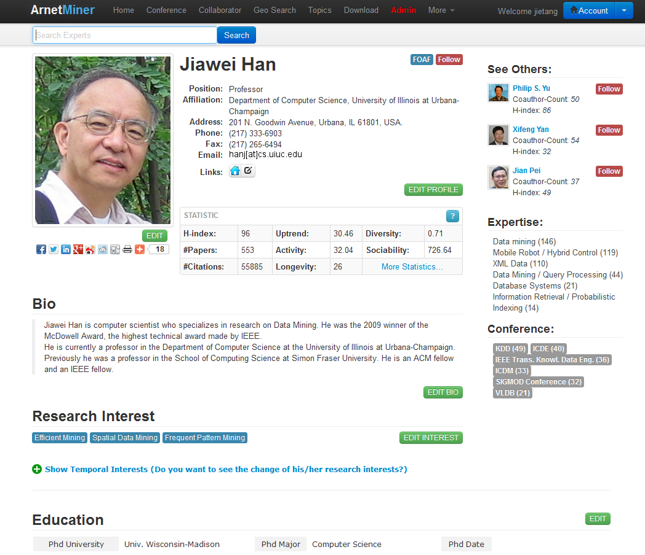
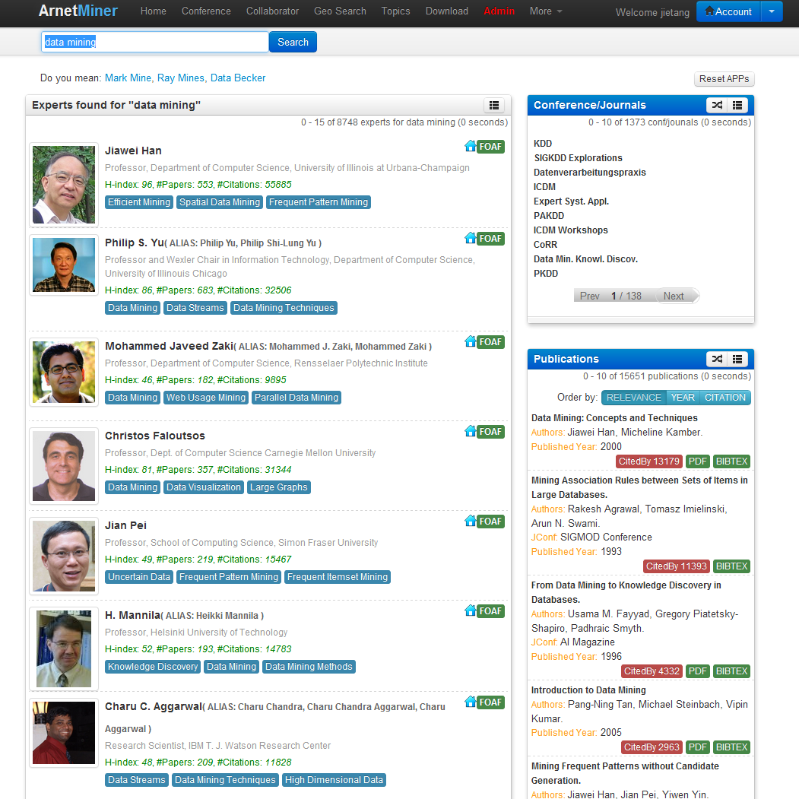
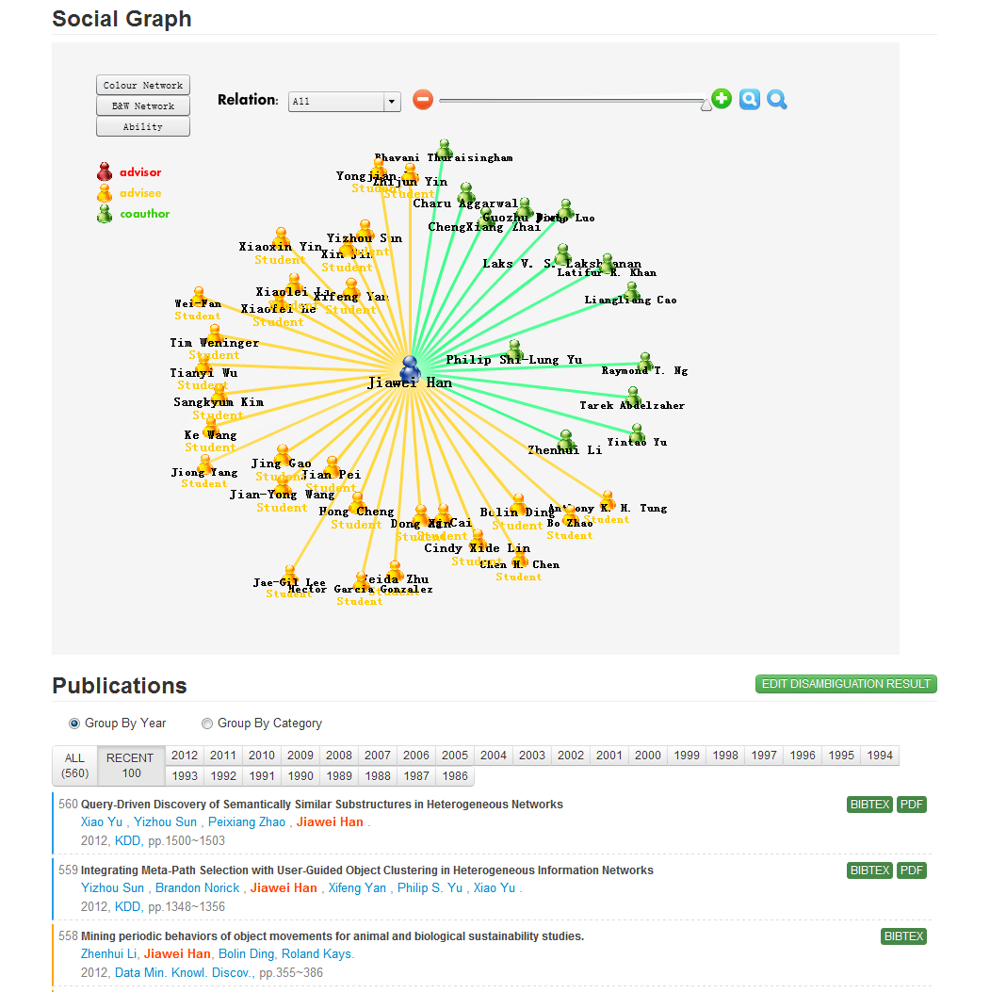
Example in my talk—AMiner.org
Academic search and mining system
Online since 2006
>136 million researcher profiles
>201 million publication papers
>341 million requests
100K IP access from 170 countries per month
Revealing patterns from scientific networks…
Notes:
基于前面的理论研究成果，我们自主研发了研究者社会网络挖掘与搜索系统Arnetminer，系统从2006年开始在线运行，收集了大量的学术数据，到目前为止，系统累积2.35TB数据，有超过1.3亿次用户访问，每月就用来自170个国家的10万用户访问。

Slide 31
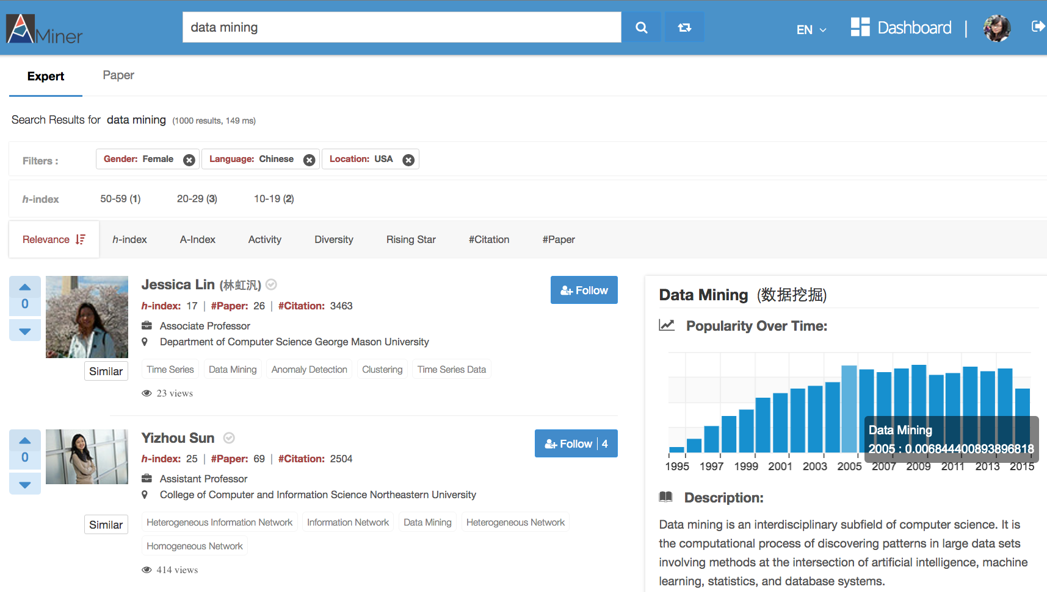
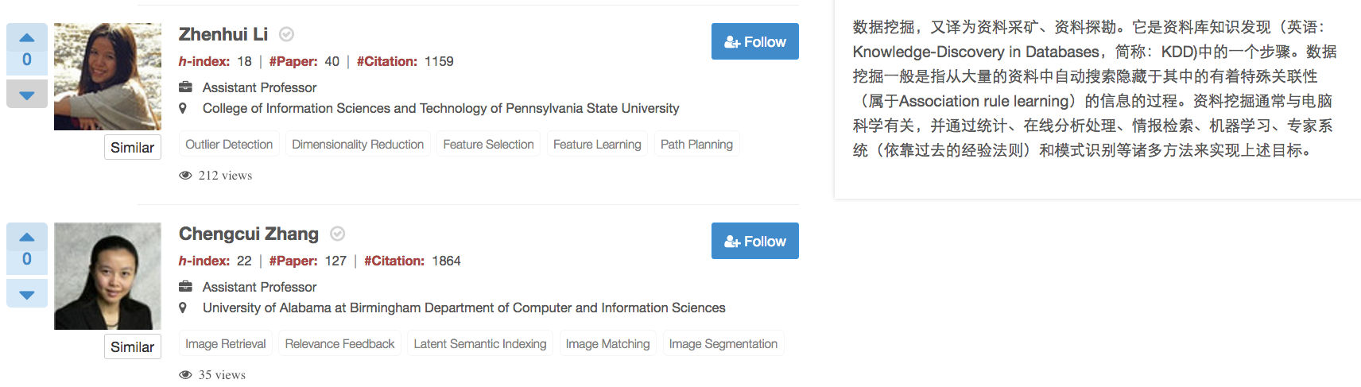
Expert.ai
Find female experts from USA working on “Data Mining” and who can speak “Chinese”
Notes:
P40: 这是为科研人员提供的一个典型服务：智能专家搜索。例如寻找在“美国”做“数据挖掘”研究的“华裔女性”专家，可以得到如图所示的结果。

Slide 32
Roadmap
data
User
Tie
Structure
Heterogeneous
Micro
Macro
tie
Dynamic
Influence
- User Modeling
- Demographics
- Social Role
- Social Tie/Link
- Homophily
- Social Influence
- Triad Formation
- Community
- Group Behavior
Big&Big
social
Social Theories
Graph Theories
BIG Network

Slide 33
Profiling users by connecting multiple networks
—Who is who?
[1] Xiaotao Gu, Hong Yang, Jie Tang, and Jing Zhang. Web User Profiling using Data Redundancy. ASONAM'16. (Best Student Paper Runner-up)
[2] Yutao Zhang, Jie Tang, Zhilin Yang, Jian Pei, and Philip Yu. COSNET: Connecting Heterogeneous Social Networks with Local and Global Consistency. KDD’15, page 1485-1494.
Yuxiao Dong, Yang Yang, Jie Tang, Yang Yang, and Nitesh V. Chawla. Inferring User Demographics and Social Strategies in Mobile Social Networks. KDD'14, pages 15-24. (Report by United Nations)

Slide 34
Who is who?
User Profiling
?
User Psychology?
User Preference Mining
User Demographics
How to model a user in social network?

Slide 35
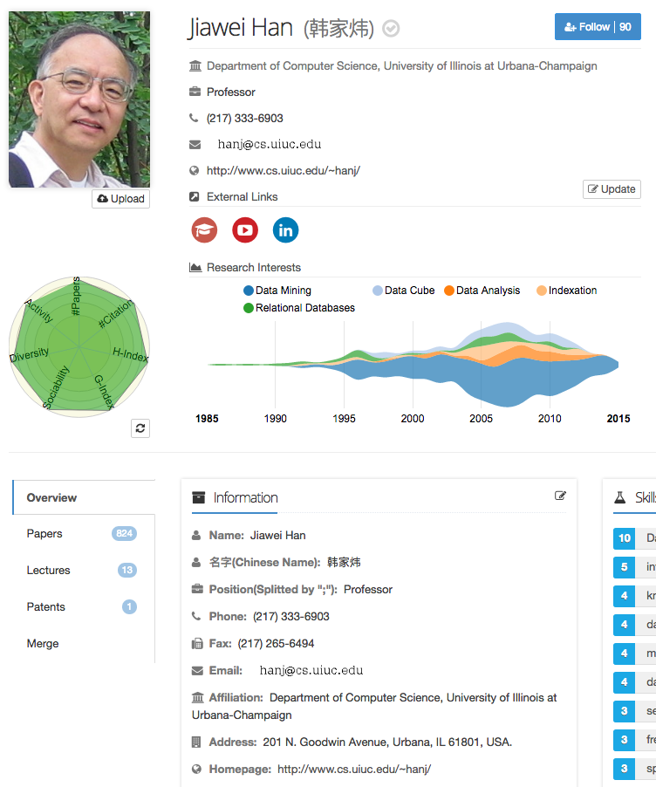
User Profiling with Big Data
Position
Phone & Fax
Email
Homepage
Affiliation
Address
Expert Finding
Recommendation
Getting in Touch
…

Slide 36
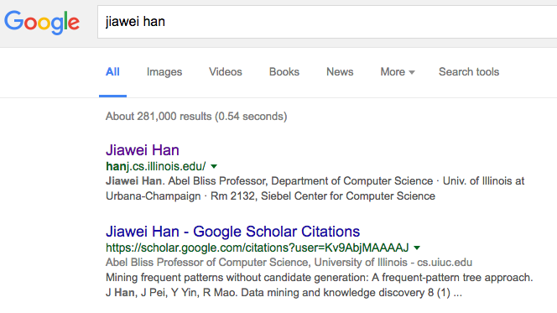
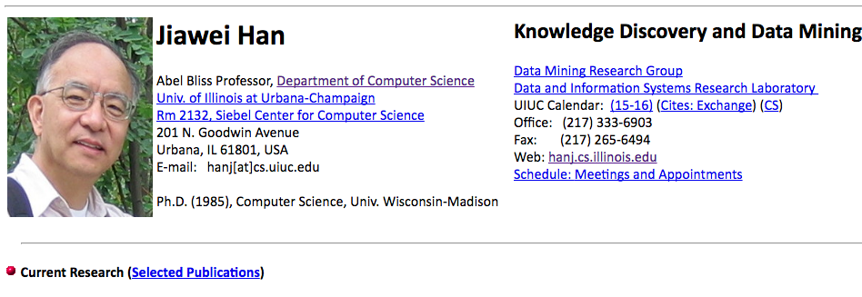
Traditional Way: Two-Step
Source Finding
Extraction

Slide 37
Traditional Way: Two-Step
Source Finding
Extraction
SVM
CRF
LR

Slide 38
Traditional Way: Two-Step
Low Recall – single data source
Low Precision – error propagation

Slide 39
Traditional Way: Two-Step
Low Recall – single data source
Low Precision – error propagation
Homepage Finding
Profile Extraction
Result
90%
*
90%
=
81%

Slide 40
Our Method: Basic Idea
A uniform framework
All in one step, avoiding error propagation
Incorporate information from different data sources: Homepage, Google Scholar, Twitter, Linkedin, Facebook, etc.
Use search engine as the data source

Slide 41
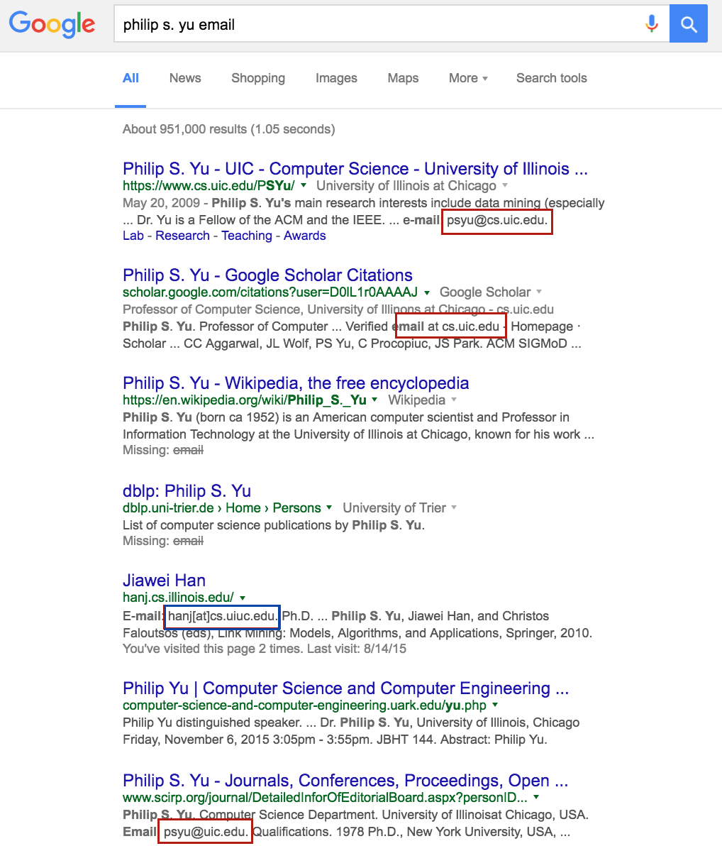
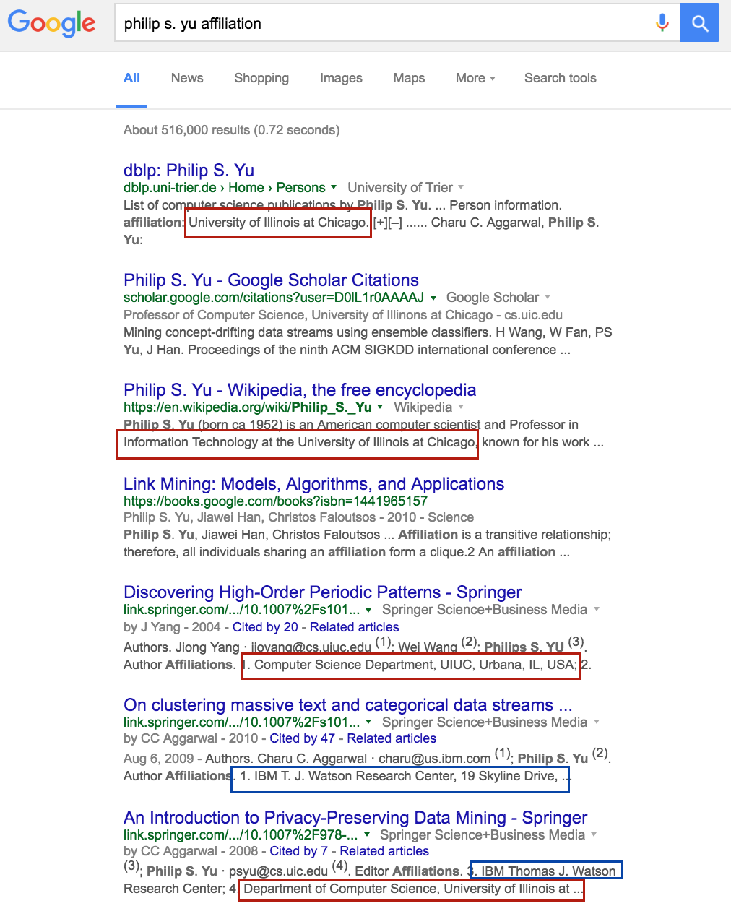
Our Method: Basic Idea
Search Engine as Data Source

Slide 42
Our Method: Basic Idea
A Uniform Framework
Search Engine as the Data Source
Smart Query Construction
Categorical : Gender, Position, Country…
Non-Categorical : Email, Affiliation, Address…
Profile Attributes

Slide 43
Query
Construction
Non-Categorical
Person_Name + Attribute_Name
Query = “Phillip S. Yu email”

Slide 44
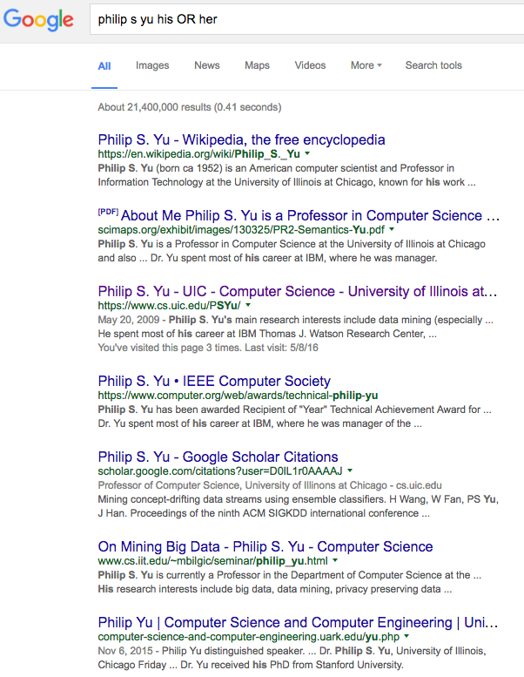
Query
Construction
Categorical
Person_Name
+ Representative Words
Query = “Phillip S. Yu his OR her”

Slide 45
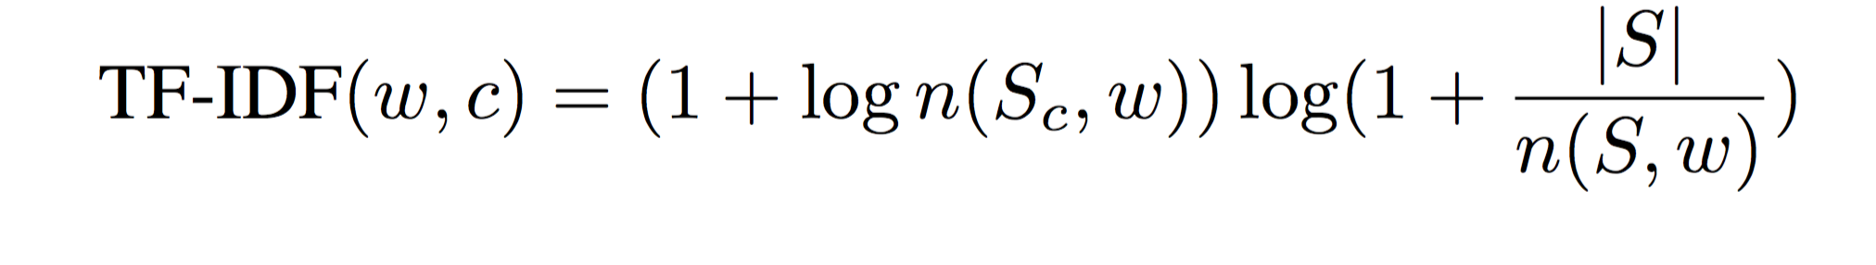
Representative Words
Male
Female
“his”
“her”
“he”
“he”
“…”
“…”
Query = “Phillip S. Yu his OR her”

Slide 46
Classification with Basic Features
Email
First name in prefix
Last name in prefix
Initials in prefix
…
Gender
How many “his”
How many “her”
…

Slide 47
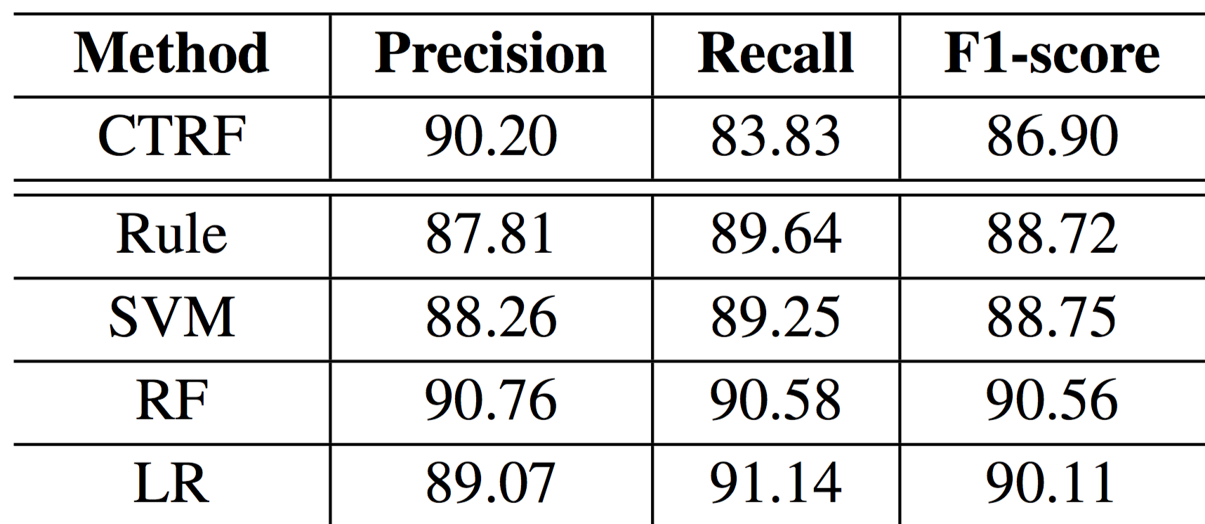
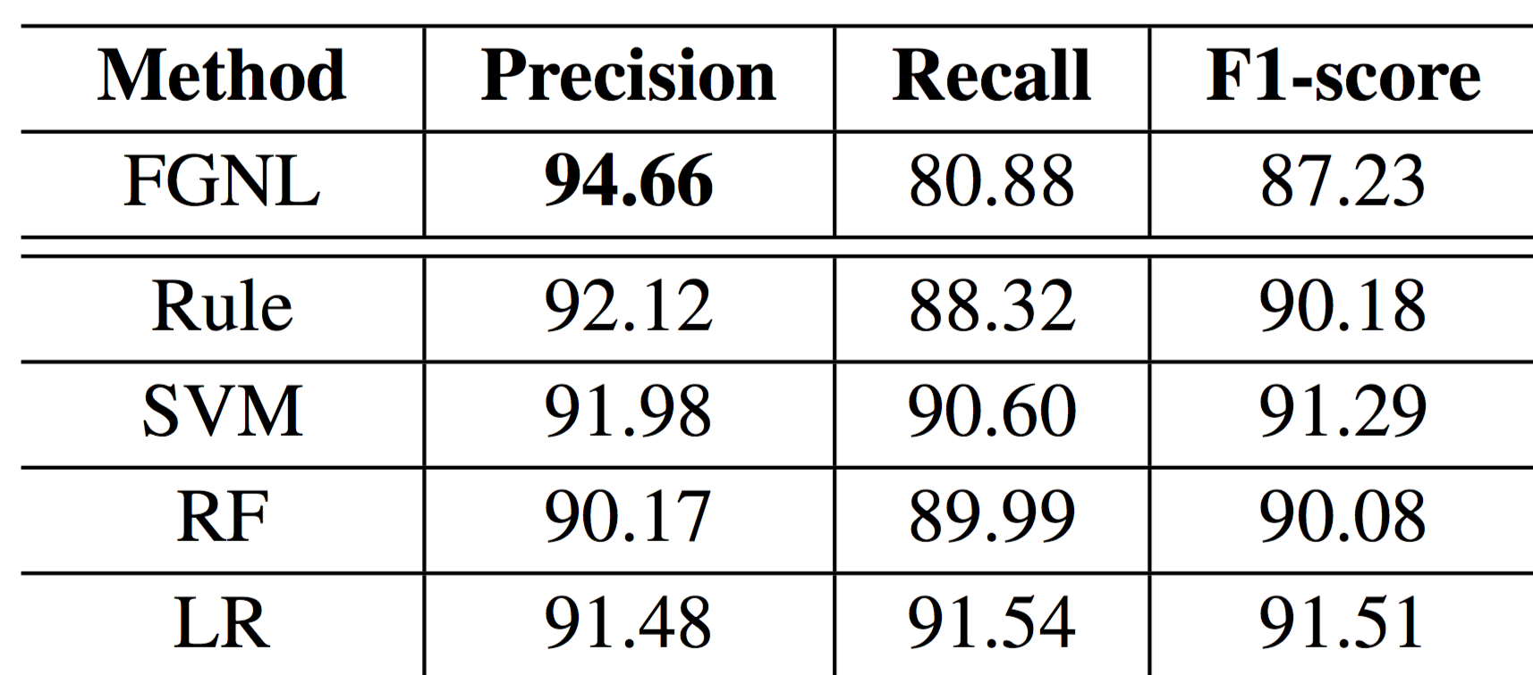
Basic Classification
Email
Gender
Uniformly outperform the baselines (CTRF, FGNL)

Slide 48
A New Model: MagicFG
- Markov Logic Factor Graph
Data Redundancy
Logic Factors
More Accurate Classification

Slide 49
Why logic factors?
Depict and utilize correlations between possible candidates from redundant data.
Incorporate human knowledge to guide and amend the classification model.

Slide 50
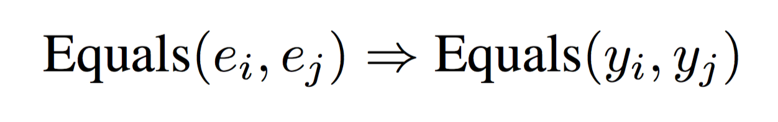
Logic Factors
Complete Consistency
Two same vertices must share the same label.
psyu@cs.uic.edu
psyu@cs.uic.edu
True
True
OR
psyu@cs.uic.edu
psyu@cs.uic.edu
False
False

Slide 51
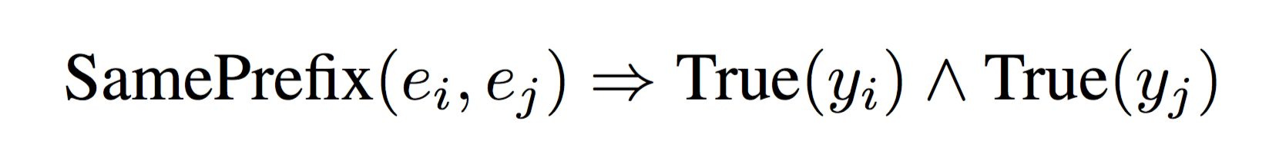
Logic Factors
Partial Consistency
Two similar vertices probably share the same (preferred) label.
e.g. Two Emails sharing the same prefix are probably both credible for the target user.
psyu@cs.uic.edu
probably
psyu@uic.edu
True
True

Slide 52
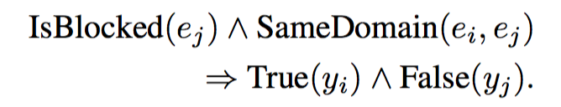
Logic Factors
Prior Knowledge
Some prior knowledge can be converted to logic factors.
e.g. Some Email addresses are modified (blocked) for some reason, whose domains are still visible and credible. Emails with the same domain with a blocked one are probably valid.
email@cs.uic.edu
probably
psyu@uic.edu
Blocked
True

Slide 53
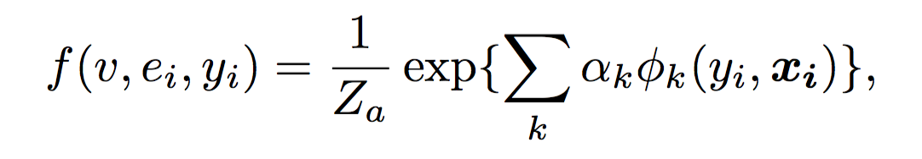
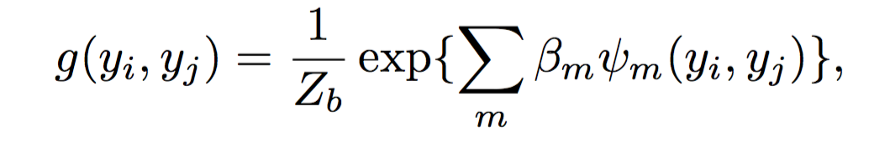
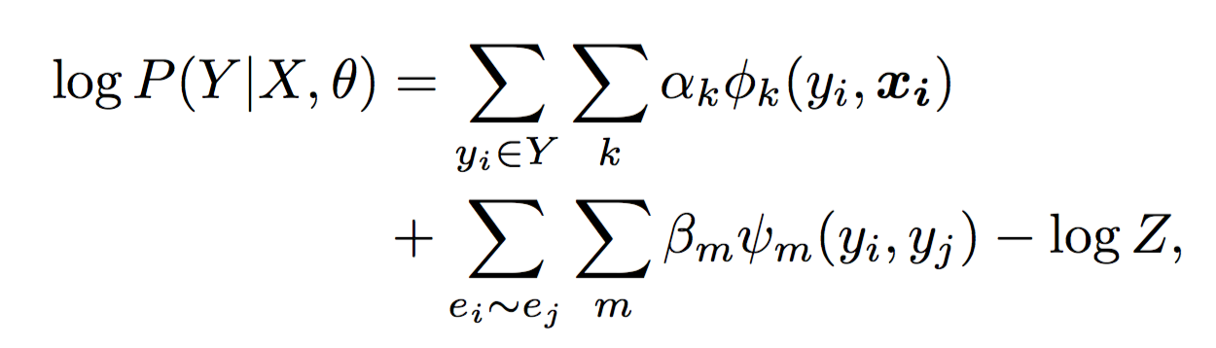
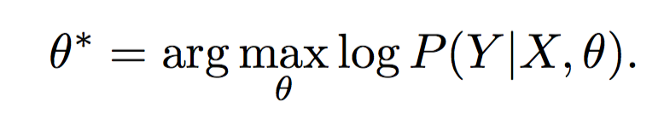
Markov Logic Factor Graph
Attribute factor function
Logic factor function
Log-likelihood function
Target parameter

Slide 54
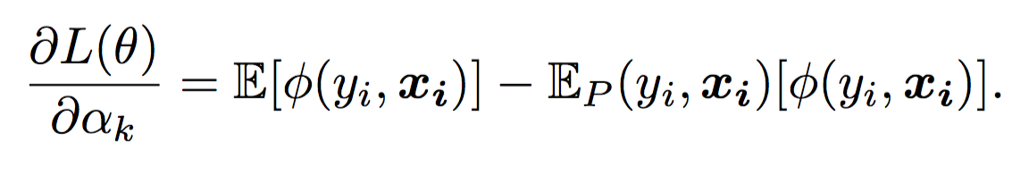
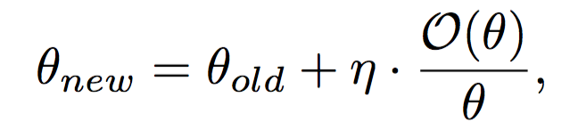
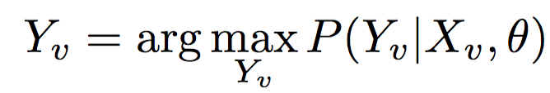
Markov Logic Factor Graph
Training: Gradient Ascent
Gradient:
Learning:
Classification:

Slide 55
Accuracy Performance
Comparison between MagicFG and state-of-the-art methods for Email and Gender extraction
Email
Gender

Slide 56
Accuracy Performance
Logic factors do help!
Email
Gender

Slide 57
Beyond Profile Extraction —connecting multiple networks

Slide 58
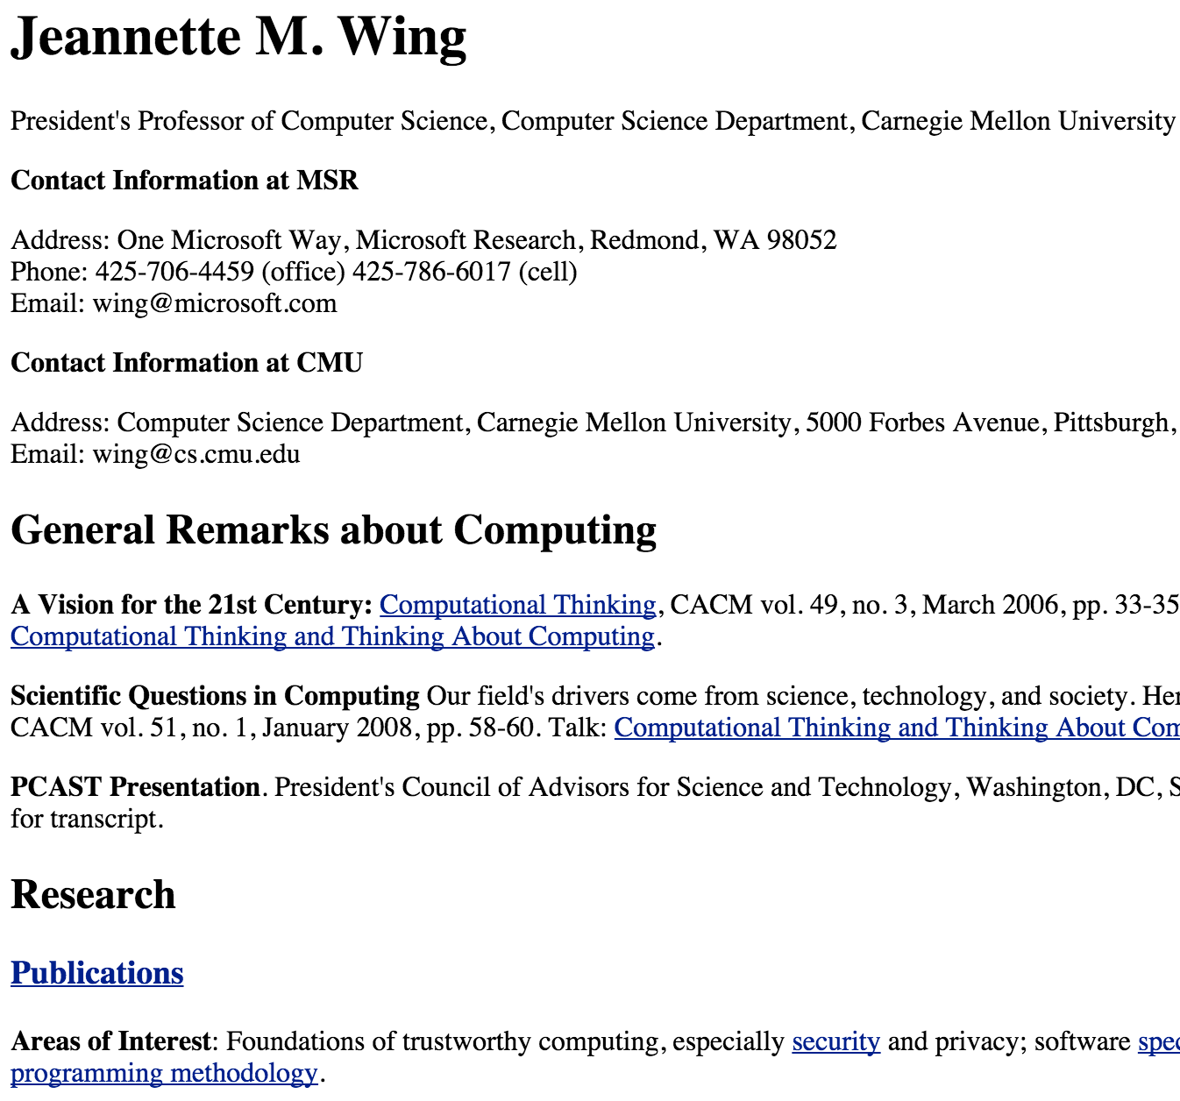
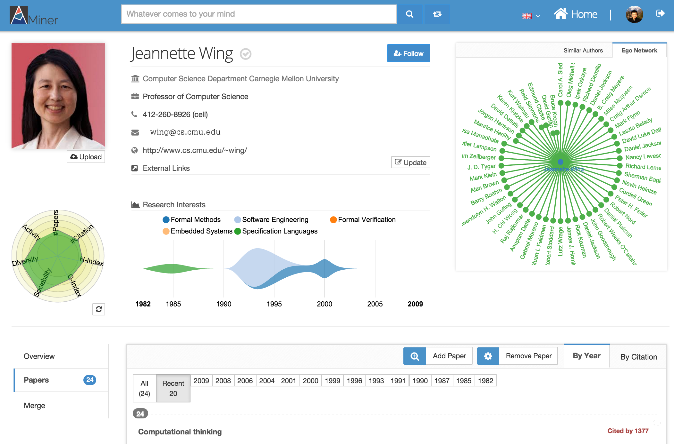
Model user profiles
Homepage
A common method: Finding the homepage (relevant pages) and extract profile attributes.
However, the extracted information is correct but not precise…

Slide 59
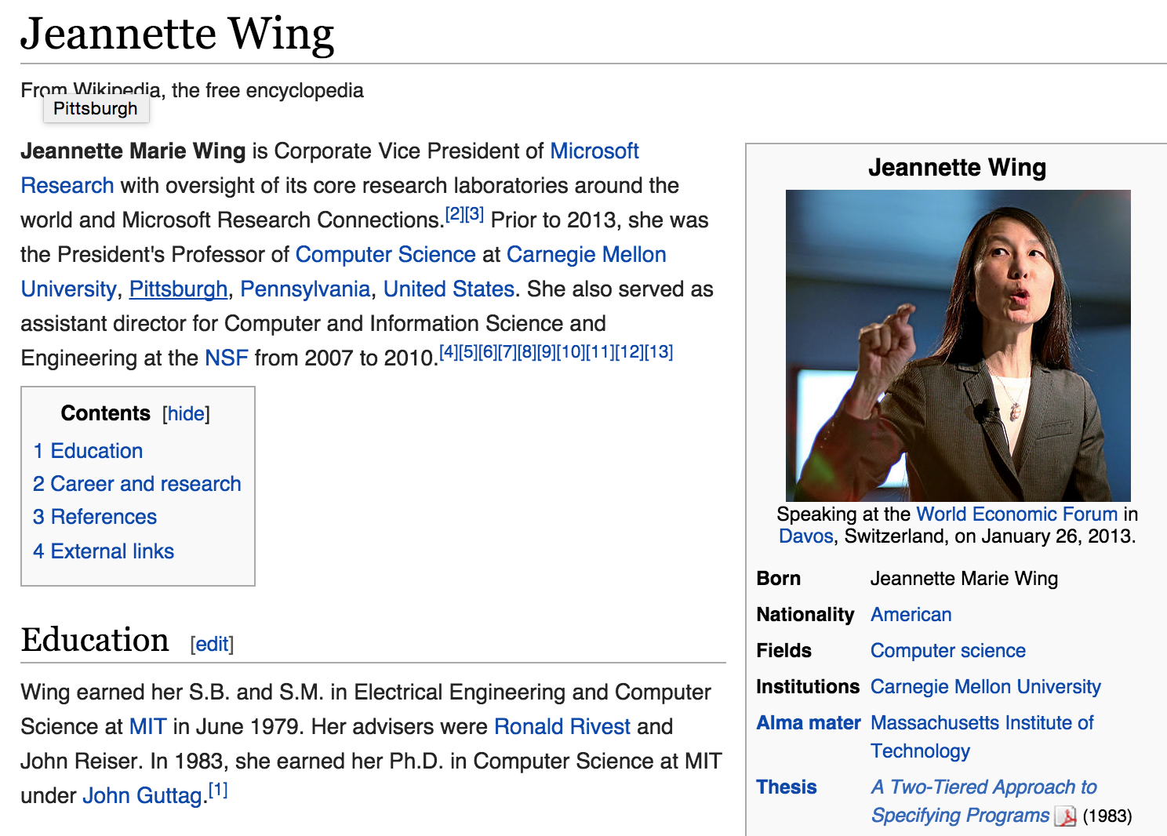

User profiles are distributed…
Some information goes out of date…
Many information is semi-structured—the key is not extraction.
Wikipedia
Homepage
LinkedIn
AMiner

Slide 60
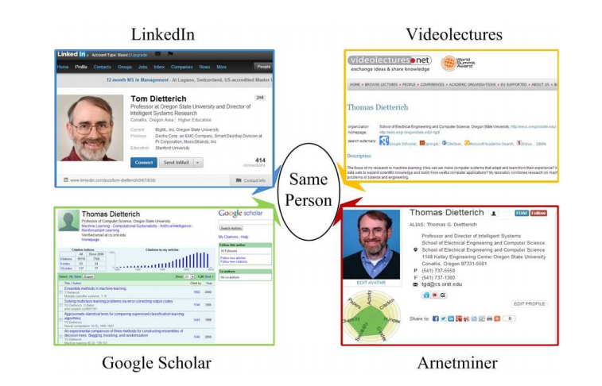

Connecting Multiple Networks
Identifying users from multiple heterogeneous networks and integrating semantics from the different networks together.
LinkedIn
Wikipedia
Jeannette Wing
Jeannette Wing
Google Scholar
AMiner
Notes:
is a fundamental issue in many applications

Slide 61
Considering the networks…

Slide 62

Local vs. Global consistency
Given three networks,
AMiner

Slide 63
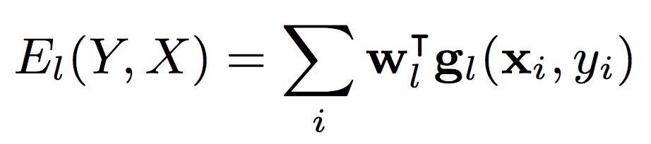
Local vs. Global consistency
Local matching: matching users by profiles
AMiner
Pairwise similarity features
Username similarity and uniqueness
Profile content similarity
Ego network similarity
Social status
Local consistency
Energy function

Slide 64
Local vs. Global consistency
Network matching: matching users’ ego networks
AMiner
Network matching
Local consistency
Encourage “neighborhood-preserving matching”

Slide 65
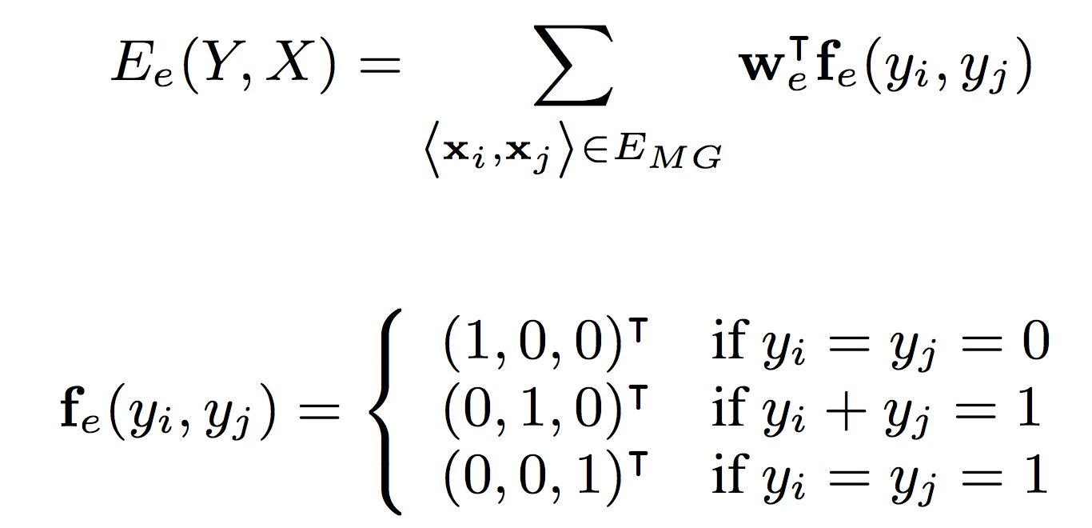
Network Matching
Network matching: matching users’ ego networks
Input networks
Matching graph
Energy function

Slide 66
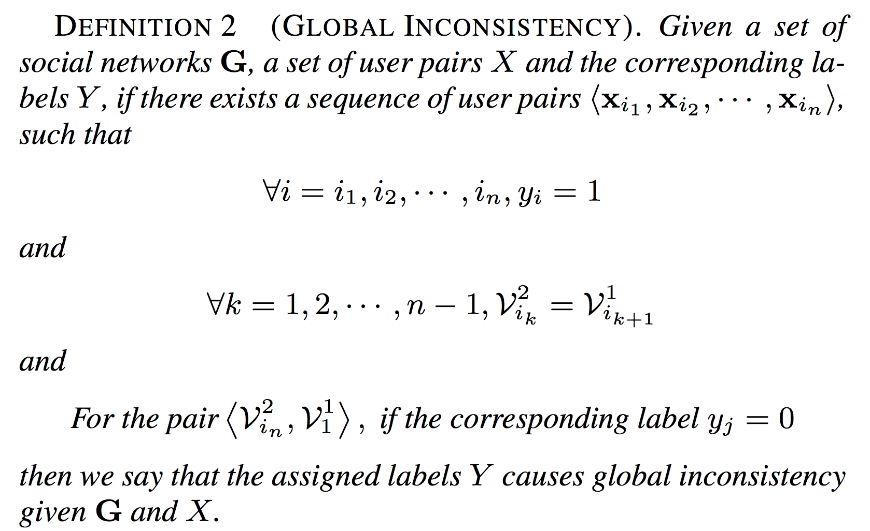
Local vs. Global consistency
Global consistency: matching users by avoiding global inconsistency
AMiner
Network matching
Local consistency
Global inconsistency
Avoid “global inconsistency”

Slide 67
Local vs. Global consistency
Global consistency: matching users by avoiding global inconsistency
AMiner
Network matching
Local consistency
x
Global inconsistency
x
x
x
x
x

Slide 68



Local vs. Global consistency
Global consistency: matching users by avoiding global inconsistency
AMiner
Network matching
Local consistency
x
Inconsistent!
Global inconsistency
x
x
x
x
x

Slide 69
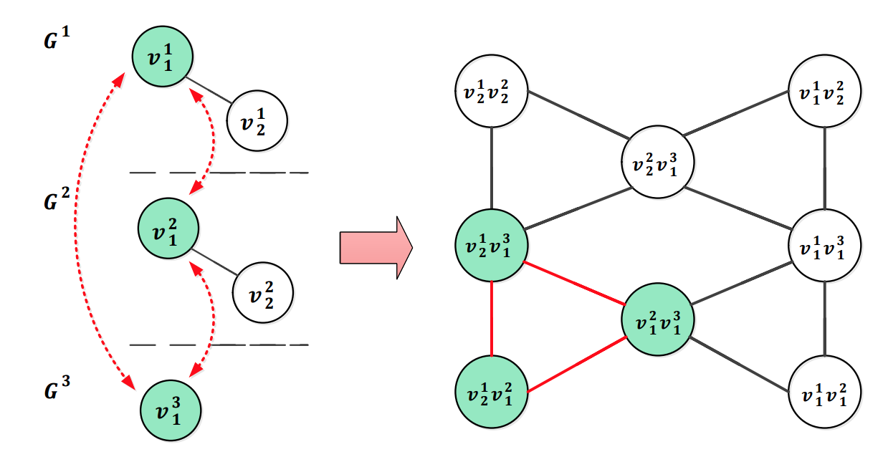
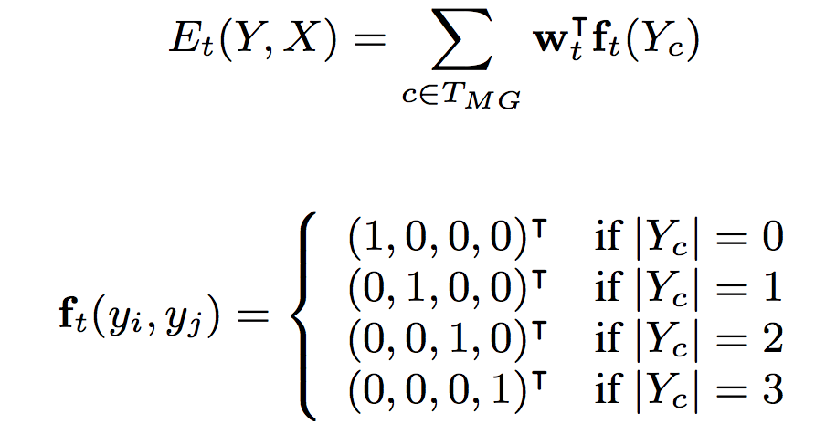
Avoid global inconsistency
Input networks
Matching graph
Energy function

Slide 70
COSNET: Connecting Social Networks with Local and Global Consistency
Input: G={G¹, G², …, G^{m}}, with G^{k}=(V^{k}, E^{k}, R^{k})
Formalization: X={x_{i}}, all possible pairwise matchings and each corresponds to
COSNET: an energy-based model
[1] Yutao Zhang, Jie Tang, Zhilin Yang, Jian Pei, and Philip Yu. COSNET: Connecting Heterogeneous Social Networks with Local and Global Consistency. KDD’15, page 1485-1494.

Slide 71
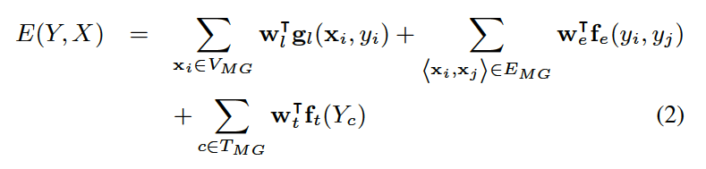
Model Construction
Objective function by combining all the energy functions

Slide 72
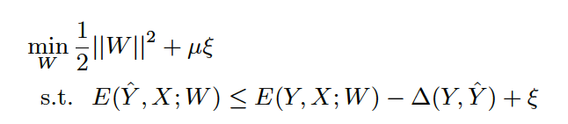
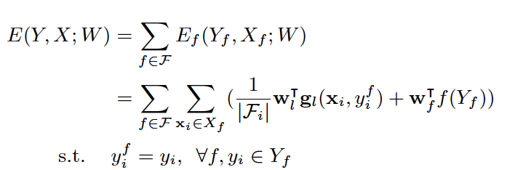
Model Learning
Max-margin learning
As the original problem is intractable, we use Lagrangian relaxation to decompose the original objective function into a set of easy-to-solve sub-problems

Slide 73


Model Learning (cont.)
Dual decomposition
This provides a lower bound to the original function
The resulting objective function is convex and non-differentiable, and can be solved by projected sub-gradient method

Slide 74

Model Learning (cont.)

Slide 75
Results

Slide 76




Researcher Profile
LinkedIn
VideoLectures
USPTO

Slide 77
Data Sets
Dataset | Network | #Users | #Relationships
SNS | Twitter | 40,171,624 | 1,468,365,182
 | LiveJournal | 3,017,286 | 87,037,567
 | Flickr | 215,495 | 9,114,557
 | Last.fm | 136,420 | 1,685,524
 | MySpace | 854,498 | 6,489,736
Academia | LinkedIn | 2,985,414 | 25,965,384
 | ArnetMiner | 1,053,188 | 3,916,907
 | VideoLectures | 11,178 | 786,353
Ground Truth
Thank Shlomo Berkovsky, Terence Chen, and Dali Kaafar for sharing the SNS data with ground-truth [28].
In Academia, we chose 10,000 authors from ArnetMiner who were connected with LinkedIn profiles and VideoLectures profiles as the ground truth.
Data&codes: https://aminer.org/cosnet

Slide 78

Connecting AMiner with …
LinkedIn and VideoLectures
Name-match: match name only;
SVM: use classifier to identify the same user;
MNA: an optimization method;
SiGMa: local propagation;
COSNET: our method;
COSNET-: w/o global consistency.
Data&codes: https://aminer.org/cosnet

Slide 79
Connecting Social Media Sites
Twitter, LiveJournal, Last.fm, Flickr, MySpace
Name-match: match name only;
SVM: use classifier to identify the same user;
MNA: an optimization method;
SiGMa: local propagation;
COSNET: our method;
COSNET-: w/o global consistency.
Data&codes: https://aminer.org/cosnet

Slide 80
Effects of Global Consistency
COSNET-: w/o global consistency.
Academia Collection
SNS Collection

Slide 81
Roadmap
data
User
Tie
Structure
Heterogeneous
Micro
Macro
tie
Dynamic
Influence
- User Modeling
- Demographics
- Social Role
- Social Tie/Link
- Homophily
- Social Influence
- Triad Formation
- Community
- Group Behavior
Big&Big
social
Social Theories
Graph Theories
BIG Network

Slide 82
This part…
Info. Space vs. Social Space
Problem 1: Who is who? (heterogeneity)
Info. Space
Problem 2:How people interact with each other?
Social Space
Interaction
[1] Jie Tang, Tiancheng Lou, Jon Kleinberg, and Sen Wu. Transfer Learning to Infer Social Ties across Heterogeneous Networks. ACM TOIS, 2016, Volume 34, Issue 2, Article No. 7.
[2] Tiancheng Lou, Jie Tang, John Hopcroft, Zhanpeng Fang, Xiaowen Ding. Learning to Predict Reciprocity and Triadic Closure in Social Networks. ACM TKDD, 2013, Volume 7, Issue 2, Article No. 5.
[3] Wenbin Tang, Honglei Zhuang, and Jie Tang. Learning to Infer Social Ties in Large Networks. PKDD'11, pages 381-397. (Best Student Paper Runner-up)

Slide 83



Social Tie Analysis
Family
?
Inferring social ties
Friend
?
Reciprocity
You
Lady Gaga
You
Lady Gaga
Triadic Closure
You
You
?
Lady Gaga
Shiteng
Lady Gaga
Shiteng
KDD 2010, PKDD 2011 (Best Paper Runnerup), WSDM 2012, ACM TKDD

Slide 84
Inferring Social Ties
Family
?
Friend
KDD 2010, PKDD 2011 (Best Paper Runnerup), WSDM 2012, DMKD

Slide 85




Real social networks are complex...
Nobody exists only in one social network.
Public network vs. private network
Business network vs. family network
However, existing networks (e.g., Facebook and Twitter) are trying to lump everyone into one big network
FB tries to solve this problem via lists/groups
However…
Google+
which circle? Users do not take time to create it.
Notes:
Nobody exists only in one social network. We have public network and private network; we also have business network and family network. [慢] If you went to a bar last night, I do not think you want to share that information with your family or business networks.
[Click] However, existing online social networks such as Facebook and Twitter are trying to lump everyone into one big social network. For such a problem, Facebook tries to solve it by allowing users to creating friend lists.
[Click] However, the problem is far from solved. Ok, let me ask a question here: how many of you are using the Facebook lists to group all your friends? [手势] Please raise your hand…..
[看一圈] OK, around 10(….) percent, I don’t use either.
Actually, on Facebook, many users are trying to get around of this trouble by creating multiple accounts, which is obviously tedious for most users.
[Click] Recently, Google launched a new project Google+ for supporting “real-life” sharing. One key feature of Google+ is to allow users to build circles of friends. However, no matter how successful Google+ will be, one critical fact that we have to face with is that users do not often take the time to create and maintain their friend list.

Slide 86
Even complex than we imaged!
Only 16% of mobile phone users in Europe have created custom contact groups
users do not take the time to create it
users do not know how to circle their friends
The fact is that our social network is black-white…
Notes:
Indeed, one survey of mobile phone users in Europe shows that only 16% of users have created contact groups on their mobile phones. One reason is that users do not take the time to do it; and the other reason is that the users do not know how to circle their friends—in real life, people’s social circles is very dynamic and many circles overlap with each other. [慢] Your enemies of yesterday may become your friends tomorrow.
[Click] So the fact is, our online social network is still black and white.

Slide 87

Example 1: finding boss in email networks (PKDD’11, Best Paper Runnerup)
Enterprise email network
CEO
How to infer
Manager
Employee
User interactions may form implicit groups

Slide 88


Example 2: finding friends in mobile networks
Friends
Other
From Home
08:40
Both in office
08:00 – 18:00
0.89
0.98
From Office
11:35
0.77
From Office
15:20
From Office
17:55
0.63
0.70
From Outside
21:30
0.86
Notes:
Let me give some concrete examples of our problem. The first example is the mobile communication network. Mobile users communicate with each other by making calls and sending text messages. [Click] What we want to do is to infer the friendship in the communication network.

Slide 89


Challenges
What are the fundamental forces behind?
Can we automatically infer the type of social ties?
Publication network
From Home
08:40
Both in office
08:00 – 18:00
Twitter’s following network
From Office
11:35
From Office
15:20
From Office
17:55
From Outside
21:30
Mobile communication network

Slide 90
Networks
Epinions a network of product reviewers: 131,828 nodes (users) and 841,372 edges
trust relationships between users
Slashdot: 82,144 users and 59,202 edges
“friend” relationships between users
Mobile: 107 mobile users and 5,436 edges
to infer friendships between users
Coauthor: 815,946 authors and 2,792,833 coauthor relationships
to infer advisor-advisee relationships between coauthors
Enron: 151 Enron employees and 3572 edges
to infer manager-subordinate relationships between users.
Undirected network
Directed network

Slide 91
Problem Formulation
Input: G=(V,E^{L},E^{U},R^{L},W)
Partially Labeled Network
Other
Friend
V: Set of Users
E^{L},R^{L}: Labeled relationships
?
?
?
E^{U}: Unlabeled relationships
Other
Input:
G=(V,E^{L},E^{U},R^{L},W)
Output:
f: G→R
Notes:
Now let’s give a formal definition of this problem. Basically, the input is a social network, which contains [Click] a set of users. In the social network, some relationships may be [Click] labeled, [Click] but most are not. Therefore, the input is a [Click] partially label network. [Click] In this problem, the input is a partially labeled network G, the objective is to learn a mapping function f, which can predict the relationship semantics for each relationship in the input social graph. It should be noted that, the partially-labeled property is very important. To learn a high-quality predictive model, we should not only consider the labeled information, but also the unlabeled network structure information.

Slide 92
Basic Idea
V₁
V₃
V₂
?
Friend
?
User→Node
?
?
r₂₄
r₅₆
Other
r₄₅
Relationship→Node
Notes:
Now, let’s discuss about the solutions. In general, there are two ways to model the problem. The first way is to model each user as a node [Click]. And another way is to model each relationship as a node [Click]
The first way is more intuitive, but it’s difficult to model the some correlations between different relationships. We use the second model.

Slide 93

Partially Labeled Pairwise Factor Graph Model (PLP-FGM)
Constraint factor h
y₂₁=Friend
Partially Labeled
Model
y₁₂=Friend
Latent Variable
y₁₆=Other
Correlation factor g
Problem:
For each relationship, identify which type
has the highest probability?
Attribute factors f
Input
Model
Map relationship to nodes in model
Example: A makes call to B immediately after the call to C.
Example: Call frequency between two users?
[1] Wenbin Tang, Honglei Zhuang, and Jie Tang. Learning to Infer Social Ties in Large Networks. In ECML/PKDD'2011. pp. 381-397. (Best Student Paper Runner-up)
Notes:
Now we introduce our partially labeled pairwise factor graph model in detail. Take the mobile network as example. The left side is input mobile social network. [Click] And the right side is the formulized model. [Click] Each relationship in the input network is mapped to a relationship node in the model. [click]
For each relationship node, we have a corresponding latent variable y. [click] The value of latent variable indicates the type of relationship.
In this model, we define three different factors.
The first factor is attribute factor. For each relationship, there may exist some user-specific/link-specific attributes which can reflect the relationship type.
For example:
How frequently two users make call to each other?
These features are added in to the model as "attribute factors.“
The second factor is correlation factor. Different relationships may have some correlations. Let's image such a situation, user Bob makes call to Alice immediately after the call to Carl. Then, the relationship between Bob and Alice, and the relationship between Bob and Carl, are very likely to be the same.
[Click]
The third factor is constraint factor. There also may exist some common knowledge that can help us to infer the relationship types.
[Click]
Finally, this model is a partially labeled model. Some of the nodes are labeled and some are not.
[Click]
Based on this model, The problem is cast as, for each relationship, identify which type has the highest probability.

Slide 94




Solutions_{(con’t)}
Different ways to instantiate factors
We use exponential-linear functions
Attribute Factor:
Correlation / Constraint Factor:
Log-Likelihood of labeled Data:

Slide 95

Learning Algorithm
Maximize the log-likelihood of labeled relationships
Expectation Computing
Loopy Belief Propagation
Gradient Ascent Method
Notes:
//算法方块放大
Learning the model, is to estimate a parameter configuration \theta, so that the log-likelihood of observation information are maximized.
[Click]
Therefore, we use gradient decent method to estimate the parameters.
[Click]
And use loopy belief propagation to compute the gradient vector.
核心要说 说清楚 Partially Labeled 的计算方式， Run两次 LBP。

Slide 96
Still Challenges?
Questions:
- How to obtain sufficiently training data?
- Can we leverage knowledge from other network?

Slide 97
Inferring Social Ties Across Networks
Epinions
Mobile
What is the knowledge to transfer?
[1] Jie Tang, Tiancheng Lou, Jon Kleinberg, and Sen Wu. Transfer Learning to Infer Social Ties across Heterogeneous Networks. ACM TOIS, 2016, Volume 34, Issue 2, Article No. 7.

Slide 98

Social Theories
Social balance theory
Structural hole theory
Social status theory
Two-step-flow theory
Observations:
(1) The underlying networks are unbalanced;
(2) While the friendship networks are balanced.
Notes:
social balance theory suggests that people in a social network are incline to form into a balanced
network structure.
The phrase the enemy of my enemy is my friend is a proverb that advances the concept that someone who is the enemy of your enemy is therefore your friend.

Slide 99


Social Theories—Structural hole
Social balance theory
Structural hole theory
Social status theory
Two-step-flow theory
Observations: Users are more likely (+25-150% higher than change) to have the same type of relationship with C if C spans structural holes
Structural hole
Notes:
The structural hole theory is an important extension of social network theory. Structural holes [1] in a social network indicate those people who can broker connections between otherwise disconnected sub networks.
Users are more likely (+70%) to have the same type of relationship with structural hole nodes.

Slide 100



Social Theories—Social status
Social balance theory
Structural hole theory
Social status theory
Two-step-flow theory
Observations: 99% of triads in the networks satisfy the social status theory
Note: Given a triad (A,B,C), let us use 1 to denote the advisor-advisee relationship and 0 colleague relationship. Thus the number 011 to denote A and B are colleagues, B is C’s advisor and A is C’s advisor.
Notes:
early 99% of Triads in The three networks satisfy the social status theory, and they share a similar distribution on the five frequent forms of triads.

Slide 101


Social Theories—Two-step-flow
Social balance theory
Structural hole theory
Social status theory
Two-step-flow theory
OL : Opinion leader;
OU : Ordinary user.
Observations: Opinion leaders are more likely (+71%-84% higher than
chance) to have a higher social-status than ordinary users.
Notes:
Opinion leaders are more likely to have a higher social-status than ordinary users.

Slide 102
Transfer Factor Graph Model
Coauthor network
Bridge via social theories
mobile

Slide 103

Mathematical Formulation
Features defined in source network
Features defined in target network
Triad-based features shared across networks
Jie Tang, Tiancheng Lou, and Jon Kleinberg. Inferring Social Ties across Heterogeneous Networks. In WSDM'2012. pp. 743-752.

Slide 104
Experiments
Data sets
Epinions: 131,828 nodes (users) and 841,372 edges
Slashdot: 82,144 users and 59,202 edges
Mobile: 107 mobile users and 5,436 edges
Coauthor: 815,946 authors and 2,792,833 coauthor relationships
Enron: 151 Enron employees and 3572 edges
Comparison methods
SVM and CRF are two baseline methods
PFG is the partially-labeled factor graph model
TranFG is the transfer–based factor graph model

Slide 105

Results – undirected networks
SVM and CRF are two baseline methods
PFG is the proposed partially-labeled factor graph model
TranFG is the proposed transfer–based factor graph model.

Slide 106

Results – directed networks
SVM and CRF are two baseline methods
PFG is the proposed partially-labeled factor graph model
TranFG is the proposed transfer–based factor graph model.

Slide 107
Parasocial vs. Reciprocal
?
You
Lady Gaga
You
Lady Gaga
[1] Tiancheng Lou, Jie Tang, John Hopcroft, Zhanpeng Fang, Xiaowen Ding. Learning to Predict Reciprocity and Triadic Closure in Social Networks. ACM TKDD, 2013, Volume 7, Issue 2, Article No. 5.

Slide 108




Who will follow you back?
On Twitter…
30%
?
100%
?
60%
?
JimmyQiao
Ladygaga
1%
?
Shiteng
Obama
Huwei
Notes:
Here is an example on Twitter, one morning, you add 4 new followers : Ladygaga, Weiyu(Shen), Bangsheng and Liwen.
Do you think they will follow you back? The answer is only No, but also Yes sometimes.
What we did is to try to build a learning framework to compute the probability of follow-backs.
In this example, for Ladygaga, the probability is 1, because she use tools to do follow-back automatically.
And, someone’s follow-back probability is really low, and others’ share different probabilities.

Slide 109




Geographic Distance
Local
vs
Global
John E. Hopcroft, Tiancheng Lou, and Jie Tang. Who Will Follow You Back? Reciprocal Relationship Prediction. In CIKM'2011. pp. 1137-1146.
Notes:
We first describe some high-level investigation of how different factors influence the formation of follow-back relationships, because the motivation of our work is to find the underlying factors and their influence to this task.
We study the following factors.
Geographic distance, do users have a higher probability to follow each other when they are located in the same region?
Firstly, the geographic distance is already not a factor to stop users from developing a reciprocal relationship, because the probabilities of follow-back for different distance are almost the same..But, acorrding to the average number of reciprocal relationships between users from the same time zone is about 50 times higher than others.
Homophily, the principle of homophily suggests that users with similar characteristics tend to associate with each other.
The left figure clearly shows that the probability of two users following back each other when they share commone nieghbors is much higher than usual.
The right figure shows that, elite users have a much stronger tendency to follow each other : more precisely, the follow-back probability between elite users is 8 times higher than ordinary uers. The (alpha, beta) algorithm seems able to better distinguish elite users from ordinary users in our problem setting, because it also considers the community structure among elite users.
On Twitter, besides the explicit network with following links, there are also some implcit network structure that can be induced from the textural information. When users A and B retweet or reply each other’s tweet, the likelihood of their following back each other is 3 times higher than chance. Another intesresting phenomenon is that, compared with replying someone’s tweet, retweeting (forwarding) her tweet seems to be more helpful (15% vs 9%)
Now, we connect our work to a basic social theory, structural balance theory. We examine how the Twitter network satisfy the structural balance property.
The network of two-way relationships on Twitter is balanced (88%), while the network of one-way relationships is not (only 29%).

Slide 110


Homophily
Link homophily: users who share common links will have a tendency to follow each other.
Status homophily: Elite users have a much stronger tendency to follow each other.
Notes:
We first describe some high-level investigation of how different factors influence the formation of follow-back relationships, because the motivation of our work is to find the underlying factors and their influence to this task.
We study the following factors.
Geographic distance, do users have a higher probability to follow each other when they are located in the same region?
Firstly, the geographic distance is already not a factor to stop users from developing a reciprocal relationship, because the probabilities of follow-back for different distance are almost the same..But, acorrding to the average number of reciprocal relationships between users from the same time zone is about 50 times higher than others.
Homophily, the principle of homophily suggests that users with similar characteristics tend to associate with each other.
The left figure clearly shows that the probability of two users following back each other when they share commone nieghbors is much higher than usual.
The right figure shows that, elite users have a much stronger tendency to follow each other : more precisely, the follow-back probability between elite users is 8 times higher than ordinary uers. The (alpha, beta) algorithm seems able to better distinguish elite users from ordinary users in our problem setting, because it also considers the community structure among elite users.
On Twitter, besides the explicit network with following links, there are also some implcit network structure that can be induced from the textural information. When users A and B retweet or reply each other’s tweet, the likelihood of their following back each other is 3 times higher than chance. Another intesresting phenomenon is that, compared with replying someone’s tweet, retweeting (forwarding) her tweet seems to be more helpful (15% vs 9%)
Now, we connect our work to a basic social theory, structural balance theory. We examine how the Twitter network satisfy the structural balance property.
The network of two-way relationships on Twitter is balanced (88%), while the network of one-way relationships is not (only 29%).

Slide 111

Interaction
Retweet vs. reply
*Retweeting seems to be more helpful
Notes:
We first describe some high-level investigation of how different factors influence the formation of follow-back relationships, because the motivation of our work is to find the underlying factors and their influence to this task.
We study the following factors.
Geographic distance, do users have a higher probability to follow each other when they are located in the same region?
Firstly, the geographic distance is already not a factor to stop users from developing a reciprocal relationship, because the probabilities of follow-back for different distance are almost the same..But, acorrding to the average number of reciprocal relationships between users from the same time zone is about 50 times higher than others.
Homophily, the principle of homophily suggests that users with similar characteristics tend to associate with each other.
The left figure clearly shows that the probability of two users following back each other when they share commone nieghbors is much higher than usual.
The right figure shows that, elite users have a much stronger tendency to follow each other : more precisely, the follow-back probability between elite users is 8 times higher than ordinary uers. The (alpha, beta) algorithm seems able to better distinguish elite users from ordinary users in our problem setting, because it also considers the community structure among elite users.
On Twitter, besides the explicit network with following links, there are also some implcit network structure that can be induced from the textural information. When users A and B retweet or reply each other’s tweet, the likelihood of their following back each other is 3 times higher than chance. Another intesresting phenomenon is that, compared with replying someone’s tweet, retweeting (forwarding) her tweet seems to be more helpful (15% vs 9%)
Now, we connect our work to a basic social theory, structural balance theory. We examine how the Twitter network satisfy the structural balance property.
The network of two-way relationships on Twitter is balanced (88%), while the network of one-way relationships is not (only 29%).

Slide 112


Structural Balance
(A) and (B) are balanced, but (C) and (D) are not.
Structural balance
Reciprocal relationships are balanced (88%);
Parasocial relationships are not (only 29%).
Notes:
We first describe some high-level investigation of how different factors influence the formation of follow-back relationships, because the motivation of our work is to find the underlying factors and their influence to this task.
We study the following factors.
Geographic distance, do users have a higher probability to follow each other when they are located in the same region?
Firstly, the geographic distance is already not a factor to stop users from developing a reciprocal relationship, because the probabilities of follow-back for different distance are almost the same..But, acorrding to the average number of reciprocal relationships between users from the same time zone is about 50 times higher than others.
Homophily, the principle of homophily suggests that users with similar characteristics tend to associate with each other.
The left figure clearly shows that the probability of two users following back each other when they share commone nieghbors is much higher than usual.
The right figure shows that, elite users have a much stronger tendency to follow each other : more precisely, the follow-back probability between elite users is 8 times higher than ordinary uers. The (alpha, beta) algorithm seems able to better distinguish elite users from ordinary users in our problem setting, because it also considers the community structure among elite users.
On Twitter, besides the explicit network with following links, there are also some implcit network structure that can be induced from the textural information. When users A and B retweet or reply each other’s tweet, the likelihood of their following back each other is 3 times higher than chance. Another intesresting phenomenon is that, compared with replying someone’s tweet, retweeting (forwarding) her tweet seems to be more helpful (15% vs 9%)
Now, we connect our work to a basic social theory, structural balance theory. We examine how the Twitter network satisfy the structural balance property.
The network of two-way relationships on Twitter is balanced (88%), while the network of one-way relationships is not (only 29%).

Slide 113
Triad Factor Graph (TriFG)

Slide 114
Experiments
Huge sub-network of twitter
13,442,659 users and 56,893,234 following links.
Extracted 35,746,366 tweets.
Dynamic networks
With an average of 728,509 new links per day.
Averagely 3,337 new follow-back links per day.
13 time stamps by viewing every four days as a time stamp
Data | Algotithm | Precision | Recall | F1Measure | Accuracy
Test Case 1 | SVM | 0.6908 | 0.6129 | 0.6495 | 0.9590
 | LRC | 0.6957 | 0.2581 | 0.3765 | 0.9510
 | CRF | 1.0000 | 0.6290 | 0.7723 | 0.9770
 | TriFG | 1.0000 | 0.8548 | 0.9217 | 0.9910
Test Case 2 | SVM | 0.7323 | 0.6212 | 0.6722 | 0.9534
 | LRC | 0.8333 | 0.3030 | 0.4444 | 0.9417
 | CRF | 1.0000 | 0.6333 | 0.7755 | 0.9717
 | TriFG | 1.0000 | 0.8788 | 0.9355 | 0.9907

Slide 115


Effect of Time Span
Distribution of follow back time
60% for next-time stamp;
37% for following 3 time stamps.
Different settings of the time span
Performance drops sharply when two or less;
Acceptable for three time stamps.
Notes:
The left figure shows the distribution of follow-backs in different time stamps.
60% of follow-backs are performed in the next time stamp,
37% of follow-backs would be still performed in the following 3 time stamps.
The right figure lists the average prediction performance of TriFG in the two test cases with different settings of the time span.
It shows that, when setting the time span as two of less, the prediction performance of TriFG drops sharply.
The performance is acceptable, when setting it as three time stamps.

Slide 116

Case Study

Slide 117
Beyond Connection —how people influence each other?

Slide 118







User Opinion and Influence: “Love Obama”
I love Obama
I hate Obama, the worst president ever
Obama is fantastic
Obama is great!
No Obama in 2012!
He cannot be the next president!
Positive
Negative
Notes:
Obama has done just that. From social networking to his blog to his Fight the Smears campaign, Obama has made his Web 2.0 presence known. He has over 1.5 million friends on MySpace and Facebook, and he currently has over 28,000,000 followers on Twitter. This personal activity in social networks allows him to quickly get the word out across multiple platforms.

Slide 119

Social Interaction: Influence
Case 1: Social influence and political mobilization^{[1]}
Will online political mobilization really work?
A controlled trial (with 61M users on FB)
Social msg group: was shown with msg that indicates one’s friends who have made the votes.
Informational msg group: was shown with msg that indicates how many other.
Control group: did not receive any msg.
[1] R. M. Bond, C. J. Fariss, J. J. Jones, A. D. I. Kramer, C. Marlow, J. E. Settle and J. H. Fowler. A 61-million-person experiment in social influence and political mobilization. Nature, 489:295-298, 2012.

Slide 120

Social Influence and Political Mobilization
Social msg group v.s. Info msg group
Result: The former were 2.08% (t-test, P<0.01) more likely to click on the “I Voted” button
Social msg group v.s. Control group
Result: The former were 0.39% (t-test, P=0.02) more likely to actually vote (via examination of public voting records)
[1] R. M. Bond, C. J. Fariss, J. J. Jones, A. D. I. Kramer, C. Marlow, J. E. Settle and J. H. Fowler. A 61-million-person experiment in social influence and political mobilization. Nature, 489:295-298, 2012.

Slide 121

Example: Sentiment Analysis on Twitter
Twitter
1,414,340 users and 480,435,500 tweets
274,644,047 t-follow edges and 58,387,964 @ edges
[1] Chenhao Tan, Lillian Lee, Jie Tang, Long Jiang, Ming Zhou, and Ping Li. User-level sentiment analysis incorporating social networks. In KDD’11, pages 1397–1405, 2011.

Slide 122


From text sentiment to user sentiment
Obama is making the repubs look silly and petty.
Positive
Negative
Classifier with dictionary
However, the social text is really short and noisy …
User A
User-level Sentiment Analysis
Only thing we have 2 fear is Obama himself & Pelosi & Cong & liberal news & Dems &...
Positive
Barack Obama can no more disown ACORN than he could disown his own grandmother.
Negative
Classifier

Slide 123
From user sentiment to network sentiment
Who influenced who? What is the influence probability?
Can we leverage the social influence to help sentiment analysis?
1
2
I love Obama
I hate Obama, the worst president ever
Obama is fantastic
0.74
0.3
0.1
0.05
0.1
0.2
0.4
0.5
No Obama in 2012!
Obama is great!
0.7
He cannot be the next president!
Positive
Negative
Notes:
Obama has done just that. From social networking to his blog to his Fight the Smears campaign, Obama has made his Web 2.0 presence known. He has over 1.5 million friends on MySpace and Facebook, and he currently has over 60,000,000 followers on Twitter. This personal activity in social networks allows him to quickly get the word out across multiple platforms.

Slide 124

Sentiment Influence in Twitter
Shared sentiment conditioned on type of connection.
—people tend to follow the opinion of their friends
[1] Chenhao Tan, Lillian Lee, Jie Tang, Long Jiang, Ming Zhou, and Ping Li. User-level sentiment analysis incorporating social networks. In KDD’11, pages 1397–1405, 2011.

Slide 125

Selection
Connectedness conditioned on labels
—people tend to create relationships with other people who share the same opinion with them

Slide 126
Learning for network sentiment analysis
I love Obama
I hate Obama, the worst president ever
Obama is fantastic
No Obama in 2012!
Obama is great!
He cannot be the next president!
Positive
Negative
Networked Classification Model: Learning for sentiment analysis by considering the network information
Another challenge: labeled data is very limited…

Slide 127


Semi-supervised Factor Graph Model
Semi-FGM: learning to classify sentiments by considering both content and network structure in a semi-supervised fashion.
Social link
Tweets by user v₃
indicate our confidence level in labeled/unlabeled users
User-specific attributes
[1] Chenhao Tan, Lillian Lee, Jie Tang, Long Jiang, Ming Zhou, and Ping Li. User-level sentiment analysis incorporating social networks. In KDD’11, pages 1397–1405, 2011.

Slide 128

Semi-supervised Factor Graph Model
Semi-FGM: learning to classify sentiments by considering both content and network structure in a semi-supervised fashion.
Social link
Tweets by user v₃
indicate our confidence level in network-based influence
User-user factor
[1] Chenhao Tan, Lillian Lee, Jie Tang, Long Jiang, Ming Zhou, and Ping Li. User-level sentiment analysis incorporating social networks. In KDD’11, pages 1397–1405, 2011.

Slide 129

Semi-supervised Factor Graph Model
+

Slide 130

Parameter Estimation for Semi-FGM
“NoLearning”: simply use counts from the labeled subset of the data
SampleRank (“Learning”): A sampling-based learning algorithm using Metropolis–Hastings
the subset of edges in our dataset in which both endpoints are labeled
indicator function

Slide 131

SampleRank (“Learning”)
likelihood ratio of new sample Y^{new} and previous label Y for all users
Update model parameters when two results are inconsistent
Relative performance between new sample Y^{new} and previous label Y on labeled user only.

Slide 132
Results of network sentiment analysis
Twitter
1,414,340 users and 480,435,500 tweets
274,644,047 t-follow edges and 58,387,964 @ edges
Methods
SVM Vote
Semi-FGM (NoLearning)
Semi-FGM (SampleRank)
Measures
Accuracy and Macro F1

Slide 133



Slide 134

Performance

Slide 135

Performance Analysis in Different Topics

Slide 136


Results of Different Learning Algorithms

Slide 137


Twitter to Weibo

Slide 138
Now, let us think…
Sentiment influence: users influence each other
Networked user sentiments
What are the fundamental factors behind
What is behind the network of social users?
What is behind the sentiment of social users?

Slide 139
Well, what is the fundamental factor…
Info. Space vs. Social Space
From the social network research perspective, what are the fundamental factors behind?
Info. Space
Interaction
Social Space
Understanding the
mechanism of interaction dynamics

Slide 140
Topic-based Social Influence Analysis
Topics
I hate Obama
Market Strategy
Politics
Politics
Entertainment
Trademarks
I love Obama
Positive
Negative
How to?
output
Politics
0.3
0.7
0.1
0.74
0.2
0.4
0.05
0.5
0.1

Slide 141

The Solution: Topical Affinity Propagation
Basic Idea:
If a user is located in the center of a “Market” community, and is “similar” to the other users, then she/he would have a strong influence on the other users.
—Homophily theory
Strategy
Market
Market
Strategy
Market
Market
Strategy
[1] Jie Tang, Jimeng Sun, Chi Wang, and Zi Yang. Social Influence Analysis in Large-scale Networks. KDD’09, pages 807-816.

Slide 142
The Solution: Topical Affinity Propagation
Define a function to quantify the similarity between neighborhood users
Market Strategy
Politics
How “Ada” thought he influenced “Bob”?
How “Bob” thought he was influenced by “Ada”?
Politics
Estimate how a user can represent his neighbors
Market Strategy
Politics
The topic information can be obtained by any tagging system or topic modeling approach
Politics
Market Strategy
[1] Jie Tang, Jimeng Sun, Chi Wang, and Zi Yang. Social Influence Analysis in Large-scale Networks. KDD’09, pages 807-816.

Slide 143

Topical Factor Graph (TFG) Model
Asymmetric similarity
Topological feature or global constraint
Social link
Nodes that have the highest influence on the current node
User-specific attributes
Node/user
The problem is cast as identifying which node has the highest probability to influence another node on a specific topic along with the edge.

Slide 144

Topical Factor Graph (TFG)
The learning task is to find a configuration for all {y_{i}} to maximize the joint probability.
Objective function:
1. How to define?
2. How to optimize?
Notes:
目标函数P描述了隐变量y_i取任意一组值时的联合概率分布

Slide 145




How to define (topical) feature functions?
similarity
Node feature function
Edge feature function
Global feature function
or simply binary

Slide 146


Model Learning Algorithm
Sum-product:
- Low efficiency!
- Not easy for distributed learning!

Slide 147

New TAP Learning Algorithm
1. Introduce two new variables r and a, to replace the original message m.
2. Design new update rules:
How user i thought he influenced user j?
m_{ij}
How user j thought he was influenced by user i?
[1] Jie Tang, Jimeng Sun, Chi Wang, and Zi Yang. Social Influence Analysis in Large-scale Networks. In KDD, pages 807-816, 2009.

Slide 148






The TAP Learning Algorithm

Slide 149
Experiments
Data&Codes: (http://arnetminer.org/lab-datasets/soinf/)
Evaluation measures
CPU time
Case study
Application
Data set | #Nodes | #Edges
Coauthor | 640,134 | 1,554,643
Citation | 2,329,760 | 12,710,347
Film (Wikipedia) | 18,518 films 7,211 directors 10,128 actors 9,784 writers | 142,426

Slide 150


Social Influence Sub-graph on “Data mining”
On “Data Mining” in 2009

Slide 151
Real Applications —in very big Tencent networks

Slide 152
Big Data Analytics in Game Data
Online gaming is one of the largest industries on the Internet…
Facebook
250 million users play games monthly
200 games with more than 1 million active users
12% of the company’s revenue is from games
Tencent (Market Cap: ~150B $)
More than 400 million gaming users
50% of Tencent’s overall revenue is from games
Zhanpeng Fang, Xinyu Zhou, Jie Tang, Wei Shao, A.C.M. Fong, Longjun Sun, Ying Ding, Ling Zhou, and Jarder Luo. Modeling Paying Behavior in Online Social Networks. CIKM'14.

Slide 153


Two games: DNF
Dungeon & Fighter Online (DNF)
A game of melee combat between users and large number of underpowered enemies
400+ million users, the 2nd largest online game in China
Users in the game can fight against enemies by individuals or by groups

Slide 154


Two games: QQ Speed
QQ Speed
A racing game that users can partake in competitions to play against other users
200+ million users
Users can race against other users by individuals or forma a group to race together
Some users may pay…

Slide 155
Task
Given behavior log data and paying logs of online game users, predict
Will social influence play an important role in this task?
Free users -> Paying users

Slide 156

The Big social data
Statistics of the datasets

Slide 157

Demographics Analysis

Slide 158
Analysis – Social influence
Social network construction
Co-playing network
Social relationship
Social influence
Strong/Weak tie
Status
Structural influence

Slide 159

Social Influence

Slide 160

Influence + Tie Strength

Slide 161

Structural Influence
[1] J. Ugandera, L. Backstromb, C. Marlowb, and J. Kleinberg. Structural diversity in social contagion. PNAS, 109 (20):7591-7592, 2012.
Notes:
最后，我们尝试从关系的多样性上进行分析。上图展示了不同的付费邻居的结构对新付费行为的影响。在上图，我们主要考察了有4个付费邻居的情况。X轴表示这4个付费邻居不同的结构情况，y轴表示成为付费用户的概率。可以看到，如果付费邻居之间的关系越稀疏，用户成为新付费用户的概率越大。付费邻居形成的连通块越多，用户成为新付费用户的概率越大。实验结果基本和DNF一致。

Slide 162

Factorization Machines
The prediction of feature vector x_{i}:
and the corresponding objective function:
Zhanpeng Fang, Xinyu Zhou, Jie Tang, Wei Shao, A.C.M. Fong, Longjun Sun, Ying Ding, Ling Zhou, and Jarder Luo. Modeling Paying Behavior in Online Social Networks. In CIKM'14.

Slide 163


Online Test
Test setting
Two groups: test group and control group
Send msgs to invite the user to attend a promotion activity.
test group2
control group

Slide 164
Roadmap
data
User
Tie
Structure
Heterogeneous
Micro
Macro
tie
Dynamic
Influence
- User Modeling
- Demographics
- Social Role
- Social Tie/Link
- Homophily
- Social Influence
- Triad Formation
- Community
- Group Behavior
Big&Big
social
Social Theories
Graph Theories
BIG Network

Slide 165

Information Diffusion: Opinion leader vs. Structural hole spanner
Community 2
Opinion leader
Community 1
1% twitter users generated 50% original tweets.
Structural hole spanners
1% twitter users control 25% retweeting behaviors between communities.
Information diffusion across communities
Community 3
[1] S. Wu, J. M. Hofman, W. A. Mason, and D. J. Watts. Who says what to whom on twitter. In WWW’11, pages 705–714, 2011.
[2] T. Lou and J. Tang. Mining Structural Hole Spanners Through Information Diffusion in Social Networks. In WWW'13. pp. 837-848.

Slide 166

Problem Definition
Which node is the best structural hole spanner?
Community 2
Community 1
Well, mining top-k structural hole spanners is more complex…
Notes:
The input of the problem is a social network, a graph G. And associate with communities information.
So the community is the input of the our problem.
What we want to do is to maximize the following function.
Here Q, is the utility function, to measure how a subset of vertices span structural holes.
Q is a General definition, can be instantiate in many ways, like:
Number of path between communities.
Number of edges between key members among communities
And the VSH is exactly the top-k structural hole spanners we want to compete.

Slide 167

Structural hole spanners control information diffusion?
In the Coauthor network :
Structural hole spanners almost double opinion leaders on number of cross domain (and outer domain) citations.
Notes:
In coauthor, we consider the citation as a type of information diffusion.
SHS almost double OL the number of cross domain and outer domain citation.
Cross domain citation is only aimed for cites from other computer science areas.
Outer domain citation is only aimed for cites from non-CS areas, other areas like math and biology.

Slide 168

Structural hole spanners control the information diffusion
Opinion leaders 5 times higher
Structural hole spanners 3 times higher
Results: Opinion leaders controls information flows within communities, while Structural hole spanners dominate information spread across communities.
Notes:
we perform another analysis of information diffusion in the Twitter and Coauthor networks.
In twitter, we estimate the probability of OL and SHS appearing on a tweet forward path.
The result shows an interesting phenomena, OL dominate in inner domain information spread, which is 5 times higher than SHS, but on the other hand, SHS almost 3 times the cross domain information flows.

Slide 169
Problem definition
INPUT :
A social network, G = (V, E) and L communities C = (C₁, C₂, …, C_{L})
Identifying top-k structural hole spanners.
max Q(V_{SH}, C), with |V_{SH}| = k
Utility function Q(V*, C) : measure V*’s degree to span structural holes.
V_{SH} : Top-k structural holes spanners as a subset of k nodes
Notes:
The input of the problem is a social network, a graph G. And associate with communities information.
So the community is the input of the our problem.
What we want to do is to maximize the following function.
Here Q, is the utility function, to measure how a subset of vertices span structural holes.
Q is a General definition, can be instantiate in many ways, like:
Number of path between communities.
Number of edges between key members among communities
And the VSH is exactly the top-k structural hole spanners we want to compete.

Slide 170
Structural hole spanners vs. Opinion leaders
Structural hole vs. Opinion leader vs. Random
Result: Structural hole spanners are more likely to connect important nodes
+15% - 50%
The two-step information flow theory^{[1]} suggests structural hole spanners are connected with many “opinion leaders”
[1] E. Katz. The two-step flow of communication: an up-to-date report of an hypothesis. In Enis and Cox(eds.), Marketing Classics, pages 175–193, 1973.
Notes:
(1) Observation (2) case

Slide 171
Model One : HIS
Structural hole spanners are more likely to connect important nodes in different communities.
If a user is connected with many opinion leaders in different communities, more likely to span structural holes.
If a user is connected with structural hole spanners, more likely to act as an opinion leader.
Notes:
Based on the first intuition.
For example, v3 and v7 are Ols in two communities, so they have more power to spread information than other nodes v5 and v11,
V6 and v12 can be considered as the bridge to connect two communities.
And v6 have a higher advantage than v12, since v6 connects two OL and v12 only connects two ordinary users.
On the other hand, a node is more likely to act as an OL, if it connects with structural hole spanners.
We develop the first model as the following mutual recursion formulas.
I(v, C) is ..
H(v, S) is ..
A and b are ….

Slide 172
Model One : HIS
Structural hole spanners are more likely to connect important nodes in different communities.
If a user is connected with many opinion leaders in different communities, more likely to span structural holes.
If a user is connected with structural hole spanners, more likely to act as an opinion leader.
Model
I(v, C_{i}) = max { I(v, C_{i}), α_{i} I(u, C_{i}) + β_{S} H(u, S) }
H(v, S) = min { I(v, C_{i}) }
I(v, C_{i}) : importance of v in community C_{i}.
H(v, S) : likelihood of v spanning structural holes across S (subset of communities).
α and β are two parameters
Notes:
Essentially, in Eq. 2, the importance score can be explained as the maximal information flow a user can receive from one of her/his friends.
Eq. 3 suggests that a structural hole spanner in S should be active in all the communities in S. The two update rules, Eqs. 2 and 3 are the basic approaches by which structural holes and importance (authority) reinforce each other.

Slide 173


Algorithm for HIS
By PageRank or HITS
Parameter to control the convergence

Slide 174
Theoretical Analysis — Existence
Given α_{i} and β_{S}, solution exists ( I(v, C_{i}), H(v, S) ≤ 1) for any graph, if and only if, α_{i} + β_{S} ≤ 1.
For the only if direction
Suppose α_{i} + β_{S} > 1, S = {C_{blue}, C_{yellow}}
r(u) = r(v) = 1;
I(u,C_{blue}) = I(u,C_{yellow}) = 1;
H(u,S) = min { I(u, C_{blue}), I(u, C_{yellow})}=1;
I(v, C_{yellow}) ≥ α_{i} I(u, C_{i}) + β_{S} H(u, S) = α_{i} + β_{S} > 1
u
v
I(v, C_{i}) = max { I(v, C_{i}), α_{i} I(u, C_{i}) + β_{S} H(u, S) }
H(v, S) = min { I(v, C_{i}) }
Notes:
We first proof the only if direction. Suppose we have two communities, one is blue, another is yellow. Two vertex U and V are connected with each other. Vertex V belongs to yellow and vertex U belongs to both yellow and blue. And we are looking for the structural hole between blue and yellow.
Suppose alpha + beta > 1, and the initial value of u and v both equals to 1. Thus the importance scores of vertex U in blue and yellow are also one, which is the same with its structural hole score. By the updating equation, we find that I(v, C_yellow) >= alpha + beta > 1, which is impossible.

Slide 175
Theoretical Analysis — Existence
Given α_{i} and β_{S}, solution exists ( I(v, C_{i}), H(v, S) ≤ 1) for any graph, if and only if, α_{i} + β_{S} ≤ 1.
For the if direction
If α_{i} + β_{S} ≤ 1, we use induction to prove I(v, C_{i}) ≤ 1;
Obviously I⁽⁰⁾(v, C_{i}) ≤ r(v) ≤ 1;
Suppose after the k-th iteration, we have I^{(k)}(v, C_{i}) ≤ 1;
Hence, in the (k + 1)-th iteration, I^{(k+1)}(v, C_{i}) ≤ α_{i}I^{(k)}(u, C_{i}) + β_{S}H^{(k)}(u, S) ≤ (α_{i} + β_{S})I^{(k)}(u, C_{i}) ≤ 1.
I(v, C_{i}) = max { I(v, C_{i}), α_{i} I(u, C_{i}) + β_{S} H(u, S) }
H(v, S) = min { I(v, C_{i}) }

Slide 176
Theoretical Analysis — Convergence
Denote γ = α_{i} + β_{S} ≤ 1, we have
|I^{(k+1)}(v, C_{i}) - I^{(k)}(v, C_{i})| ≤ γ^{k}
When k = 0, we have I⁽¹⁾(v, C_{i}) ≤ 1, thus
|I⁽¹⁾(v, C_{i})-I⁽⁰⁾(v, C_{i})| ≤ 1
Assume after k-th iteration, we have
|I^{(k+1)}(v, C_{i})-I^{(k)}(v, C_{i})| ≤ γ^{k}
After (k+1)-th iteration, we have
I^{(k+2)}(v, C_{i}) = α_{i}I^{(k+1)}(u, C_{i}) + β_{S}H^{(k+1)}(u, S)
≤ α_{i}[I^{(k)}(u, C_{i})+γ^{k}] + β_{S}[H^{(k+1)}(u, S)+γ^{k}]
≤ α_{i}I^{(k)}(u, C_{i}) + β_{S}H^{(k+1)}(u, S) + γ^{k+1}
≤ I^{(k+1)}(u, C_{i}) + γ^{k+1}

Slide 177

Convergence Analysis
Parameter analysis.
The performance is insensitive to the different parameter settings.
Notes:
We proof condition of existance, and e-convergence property.
After designing an iteratie algorithm, we conduct parameter analysis, show that the performance……

Slide 178
Model Two: MaxD
Structural hole spanner detection: finding top-k nodes such that after removing these nodes, the decrease of the minimal cut will be maximized.
Removing V₆ decreases the minimal cut as 2
Minimal cut: the minimal number of edges to separate nodes in different communities.`
Two communities with the minimal cut as 4

Slide 179
Model Two: MaxD
Structural holes spanners play an important role in information diffusion
Q(V_{SH}, C) = MC (G, C) – MC (G \ V_{SH}, C)
MC(G, C) = the minimal cut of communities C in G.
Shapley value is defined to evaluate the contribution of each user in a cooperative game theory
—Lloyd Shapley, 1953
Notes:
The first model basicly consider the correlation between SHS and OL. but not consider information diffusion.
So, In the second model, we explicitly use information flows in the quality function.
Here we define MC() as the minimal cut of communities in the graph.
What we want to do is to find a subset of nodes, such that without them, the connection between communities would be minimized.

Slide 180
Hardness Analysis
Q(V_{SH}, C) = MC (G, C) – MC (G \ V_{SH}, C)
Hardness analysis
If |V_{SH}|= 2, the problem can be viewed as minimal node-cut problem
We already have NP-Hardness proof for minimal node-cut problem, but the graph is exponentially weighted.
Proof NP-Hardness in an un-weighted (polybounded -weighted) graph, by reduction from k-DENSEST-SUBGRAPH problem.
Notes:
The idea of the second model is straightforward, but it’s harder to find an efficient algorithm to optimize it.
Even when there are only 2 communities. The problem can be viewed as ….
………….
………. Which is not practical in real networks.
We rewrite the proof such that, the edges.

Slide 181
Hardness Analysis
Let us reduce the problem to an instance of the k-DENSEST SUBGRAPH problem
Given an instance {G’=<V, E>, k, d} of the k-DENSEST SUBGRAPH problem, n=|V|, m=|E|;
Build a graph G with a source node S and target node T;
Build n nodes connecting with S with capacity n*m;
Build n nodes for each edge in G’, connect each of them to T with capacity 1;
X₁
Y₁
1
1
n*m
1
Y₂
1
T
X₂
S
1
.
.
.
.
.
.
1
1
n*m
X_{n}
Y_{n*m}
Notes:
The idea of the second model is straightforward, but it’s harder to find an efficient algorithm to optimize it.
Even when there are only 2 communities. The problem can be viewed as ….
………….
………. Which is not practical in real networks.
We rewrite the proof such that, the edges.

Slide 182
Hardness Analysis (cont.)
Build a link from x_{i} to y_{j} with capacity 1 if the x_{i} in G’ appears on the j-th edge;
MC(G)=n*m;
The instance is satisfiable, if and only if there exists a subset
|V_{SH}|=k
such that
MC(G\V_{SH}) <= n(m-d)
X₁
Y₁
1
1
n*m
1
Y₂
1
T
X₂
S
1
.
.
.
.
.
.
1
1
n*m
X_{n}
Y_{n*m}

Slide 183
Proof: NP-hardness (cont.)
For the only if direction
Suppose we have a sub-graph consists of k nodes {x’} and at least d edges;
We can choose V_{SH}={x};
For the k-th edge y in G’, if y exists in the sub-graph, two nodes appearing on y are removed in G;
Thus y cannot be reached and we lost n flows for y;
Hence, we have MC(G \ V_{SH}) <= n*(m-d).

Slide 184
Proof: NP-hardness (cont.)
For the if direction
If there exists a k-subset V_{SH} such that MC(G\V_{SH}) <= n*(m-d);
Denote V_{SH}’=V_{SH}^{x}, the size of V_{SH}’ is at most k, and MC(G\V_{SH}’) <= n*(m-d);
Let the node set of the sub-graph be V_{SH}’, thus there are at least d edges in that sub-graph.

Slide 185
Approximation Algorithm
Two approximation algorithms:
Greedy: in each iteration, select a node which will result in a max-decrease of Q(.) when removed it from the network.
Network-flow: for any possible partitions E_{S} and E_{T}, we call a network-flow algorithm to compute the minimal cut.
Complexity: O(nkT_{l}(n)); T_{l}(n)—the complexity for computing min-cut
Complexity: O(k²T_{l}(n));
Approximation Ratio: O(n^{1/4+ε})
An example: finding top 3 structural holes
Step 1: select V8 and decrease the minimal cut from 7 to 4
Step 2: select V6 and decrease the minimal cut from 4 to 2
Step 3: select V12 and decrease the minimal cut from 2 to 0

Slide 186

Approximation Algorithm
Greedy : In each round, choose the node which results in the max-decrease of Q.
Step 1: Consider top O(k) nodes with maximal sum of flows through them as candidates.
Step 2: Compute MC(*, *) by
trying all possible partitions.
Complexity: O(2^{2l}T₂(n)); T₂(n)—the complexity for computing min-cut Approximation ratio: O(log l)
Notes:
Since the problem is NP-hard, we design approximation algorithm using greedy strategy.
In each round, we choose one node to maximal decrease of MC.
To scale up the algorithm to large networks, we only consider top O(k) nodes with
Maximal sum of flows though them as candidates.
One more challenge is to estimate MC(), when L > 2, it’s NP-Hard to get the exact number, so we design a O(logL) approximation by trying all possible partitions of communities.

Slide 187
Mining structural hole spanners
Evaluate the performance of the proposed models.

Slide 188
Experiment
 | #User | #Relationship | #Messages
Coauthor | 815,946 | 2,792,833 | 1,572,277 papers
Twitter | 112,044 | 468,238 | 2,409,768 tweets
Inventor | 2,445,351 | 5,841,940 | 3,880,211 patents
Evaluation metrics
Accuracy (Overlapped PC members in the Coauthor network)
Information diffusion on Coauthor and Twitter.
Baselines
Pathcount: #shortest path a node lies on
2-step connectivity: #pairs of disconnected neighbors
Pagerank and PageRank+: high PR in more than one communities

Slide 189

Experiments
Accuracy evaluation on Coauthor network
Predict overlapped PC members on the Coauthor network.
+20 – 40% on precision of AI-DM, DB-DM and DP-NC
What happened to AI-DM?

Slide 190

Maximization of Information Spread
Clear improvement. (2.5 times)
Top 0.2% - 10 %
Top 1% - 25 %
Improvement is limited, due to top a few authors dominate.
Improvement is statistically significant (p << 0.01)
Notes:
For the information spread maximization, we employ twitter and coauthor as the basis, we study how the detected SHS control the diffusion of information.
We can see that, on the twitter netowrk. top 0.2%.
On the coauthor network. …………

Slide 191

Efficiency
Running time of different algorithms in three data sets
HIS is very fast, but MaxD is not very efficient.

Slide 192
AMiner (ArnetMiner) —Toward understanding scientific networks
[1] J. Tang, J. Zhang, L. Yao, J. Li, L. Zhang, and Z. Su. ArnetMiner: Extraction and Mining of Academic Social Networks. KDD’08. pp.990-998.
Notes:
192

Slide 193


An author-centric academic search and mining system

Slide 194


Expert Search
Demographics: gender, language, location, etc.
Finding experts,
for “data mining”
Knowledge about
“data mining”
Similar Authors

Slide 195

Researcher Profile
Basic Info.
Research Interests
Citation Statistics
Ego Network

Slide 196

Examples – Expert search
When starting a
Work on a new research topic;
Or brainstorming for novel ideas.
Researcher
Who are experts in this field?
What are the top conferences in the field?
What are the best papers?
What are the top research labs?
?

Slide 197









Examples – Collaboration Recommendation
Data Mining
Theory
Large Graph
?
Heterogeneous Network
Automata theory
Graph
Theory
Social
Network
Complexity Theory
Notes:
Interdisciplinary collaborations have generated huge impact, for example,
51 (>1/3) of the KDD 2012 papers are result of cross-domain collaborations between graph theory, visualization, economics, medical inf., DB, NLP, IR
Research field evolution
Describe the problem
First, sparse connection, compared to traditional collaborations within a domain, cross-domain collaborations are very rare. partly because it is difficult for an outsider to find the right collaborator in the field that one does not know. This also makes it challenging to directly use a supervised learning approach due to the lack of training samples.
Second, complementary expertise, cross-domain collaborators often have different expertise and interest; For example, data mining researchers can easily identify who they want to work with in the data mining field, because they are familiar with the sub topics. However, for a cardiologist who wants to apply data mining techniques to predict heart failures, it will be difficult for her to find the right collaborators in data mining. Because these two fields (cardiology and data mining) are totally different with different terminology and problems. It is very difficult for one from cardiology to identify the right topics in data mining to look for collaborators.
Third, topic skewness, not all topics are relevant for crossdomain collaborations. In fact, in our study, only less than one-tenth of all possible topics pairs across domains have collaborations. Therefore, for the task of cross-domain collaboration recommendation, we should focus on better modeling those topics with high probability of having cross-domain collaborations

Slide 198

Examples – Reviewer Suggestion
Integration with ScholarOne: Find the extension—reviewer recommender —from Chrome Web Store
ScholarOne is a submission management system used by many journals such as IEEE Transactions and ACM Transactions.

Slide 199

User Distribution
8.32 million IP from 220 countries/regions
Notes:
截止目前，Arnetminer系统已有来自200个国家和地区277万独立IP的访问，这里列出了访问量前10的国家。

Slide 200
User Distribution
8.32 million IP from 220 countries/regions
Top 10 countries
1. USA 6. Canada
2. China 7. Japan
3. Germany 8. Spain
4. India 9. France
5. UK 10. Italy
Notes:
截止目前，Arnetminer系统已有来自200个国家和地区277万独立IP的访问，这里列出了访问量前10的国家。

Slide 201
Big Network Analysis
data
User
Tie
Topology
Heterogeneous
Micro
Macro
tie
Dynamic
Influence
- User Modeling
- Demographics
- Social Role
- Social Tie/Link
- Homophily
- Social Influence
- Triad Formation
- Community
- Group Behavior
Big&Big
social
Social Theories
Graph Theories
BIG Network

Slide 202
Future Work
data
User
Tie
Topology
Heterogeneous
Micro
Macro
Question 1: How to incorporate the huge-volume & streaming individual behavior data into network analysis?
Question 2: What is the Interplay between (Micro) Individual Behavior and (Macro) Network Distribution?
tie
Dynamic
Influence
- User modeling
- Demographics
- Social Role
- Social Tie/Link
- Homophily
- Social Influence
- Triad Formation
- Community
- Group Behavior
Big&Big
social
Social Theories
Graph Theories
BIG Network

Slide 203
Related Publications
Jie Tang, Jimeng Sun, Chi Wang, and Zi Yang. Social Influence Analysis in Large-scale Networks. In KDD’09, pages 807-816, 2009.
Chenhao Tan, Jie Tang, Jimeng Sun, Quan Lin, and Fengjiao Wang. Social action tracking via noise tolerant time-varying factor graphs. In KDD’10, pages 807–816, 2010.
Chenhao Tan, Lillian Lee, Jie Tang, Long Jiang, Ming Zhou, and Ping Li. User-level sentiment analysis incorporating social networks. In KDD’11, pages 1397–1405, 2011.
Jie Tang, Sen Wu, and Jimeng Sun. Confluence: Conformity Influence in Large Social Networks. In KDD’13, pages 347-355, 2013.
Yuxiao Dong, Yang Yang, Jie Tang, Yang Yang, Nitesh V. Chawla. Inferring User Demographics and Social Strategies in Mobile Social Networks. In KDD’14, 2014.
Jing Zhang, Biao Liu, Jie Tang, Ting Chen, and Juanzi Li. Social Influence Locality for Modeling Retweeting Behaviors. In IJCAI'13, pages 2761-2767, 2013.
Jing Zhang, Jie Tang, Honglei Zhuang, Cane Wing-Ki Leung, and Juanzi Li. Role-aware Conformity Influence Modeling and Analysis in Social Networks. In AAAI'14, 2014.
Jie Tang, Jing Zhang, Limin Yao, Juanzi Li, Li Zhang, and Zhong Su. ArnetMiner: Extraction and Mining of Academic Social Networks. In KDD’08, pages 990-998, 2008.
Tiancheng Lou and Jie Tang. Mining Structural Hole Spanners Through Information Diffusion in Social Networks. In WWW'13, pages 837-848, 2013.
Lu Liu, Jie Tang, Jiawei Han, and Shiqiang Yang. Learning Influence from Heterogeneous Social Networks. In DMKD, 2012, Volume 25, Issue 3, pages 511-544.
Tiancheng Lou, Jie Tang, John Hopcroft, Zhanpeng Fang, Xiaowen Ding. Learning to Predict Reciprocity and Triadic Closure in Social Networks. In TKDD, Vol 7(2), 2013.
Jimeng Sun and Jie Tang. A Survey of Models and Algorithms for Social Influence Analysis. Social Network Data Analytics, Aggarwal, C. C. (Ed.), Kluwer Academic Publishers, pages 177–214, 2011.
Jie Tang and Jimeng Sun. Models and Algorithms for Social Influence Analysis. In WWW’14. (Tutorial)

Slide 204
References
S. Milgram. The Small World Problem. Psychology Today, 1967, Vol. 2, 60–67
J.H. Fowler and N.A. Christakis. The Dynamic Spread of Happiness in a Large Social Network: Longitudinal Analysis Over 20 Years in the Framingham Heart Study. British Medical Journal 2008; 337: a2338
R. Dunbar. Neocortex size as a constraint on group size in primates. Human Evolution, 1992, 20: 469–493.
R. M. Bond, C. J. Fariss, J. J. Jones, A. D. I. Kramer, C. Marlow, J. E. Settle and J. H. Fowler. A 61-million-person experiment in social influence and political mobilization. Nature, 489:295-298, 2012.
http://klout.com
Why I Deleted My Klout Profile, by Pam Moore, at Social Media Today, originally published November 19, 2011; retrieved November 26 2011
S. Aral and D Walker. Identifying Influential and Susceptible Members of Social Networks. Science, 337:337-341, 2012.
J. Ugandera, L. Backstromb, C. Marlowb, and J. Kleinberg. Structural diversity in social contagion. PNAS, 109 (20):7591-7592, 2012.
S. Aral, L. Muchnik, and A. Sundararajan. Distinguishing influence-based contagion from homophily-driven diffusion in dynamic networks. PNAS, 106 (51):21544-21549, 2009.
J. Scripps, P.-N. Tan, and A.-H. Esfahanian. Measuring the effects of preprocessing decisions and network forces in dynamic network analysis. In KDD’09, pages 747–756, 2009.
Rubin, D. B. 1974. Estimating causal effects of treatments in randomized and nonrandomized studies. Journal of Educational Psychology 66, 5, 688–701.
http://en.wikipedia.org/wiki/Randomized_experiment

Slide 205
References(cont.)
A. Anagnostopoulos, R. Kumar, M. Mahdian. Influence and correlation in social networks. In KDD’08, pages 7-15, 2008.
L. Page, S. Brin, R. Motwani, and T. Winograd. The pagerank citation ranking: Bringing order to the web. Technical Report SIDL-WP-1999-0120, Stanford University, 1999.
G. Jeh and J. Widom. Scaling personalized web search. In WWW '03, pages 271-279, 2003.
G. Jeh and J. Widom, SimRank: a measure of structural-context similarity. In KDD’02, pages 538-543, 2002.
A. Goyal, F. Bonchi, and L. V. Lakshmanan. Learning influence probabilities in social networks. In WSDM’10, pages 207–217, 2010.
P. Domingos and M. Richardson. Mining the network value of customers. In KDD’01, pages 57–66, 2001.
D. Kempe, J. Kleinberg, and E. Tardos. Maximizing the spread of influence through a social network. In KDD’03, pages 137–146, 2003.
J. Leskovec, A. Krause, C. Guestrin, C. Faloutsos, J. VanBriesen, and N. Glance. Cost-effective outbreak detection in networks. In KDD’07, pages 420–429, 2007.
W. Chen, Y. Wang, and S. Yang. Efficient influence maximization in social networks. In KDD'09, pages 199-207, 2009.
E. Bakshy, D. Eckles, R. Yan, and I. Rosenn. Social influence in social advertising: evidence from field experiments. In EC'12, pages 146-161, 2012.
A. Goyal, F. Bonchi, and L. V. Lakshmanan. Discovering leaders from community actions. In CIKM’08, pages 499–508, 2008.
N. Agarwal, H. Liu, L. Tang, and P. S. Yu. Identifying the influential bloggers in a community. In WSDM’08, pages 207–217, 2008.

Slide 206
References(cont.)
E. Bakshy, B. Karrer, and L. A. Adamic. Social influence and the diffusion of user-created content. In EC ’09, pages 325–334, New York, NY, USA, 2009. ACM.
P. Bonacich. Power and centrality: a family of measures. American Journal of Sociology, 92:1170–1182, 1987.
R. B. Cialdini and N. J. Goldstein. Social influence: compliance and conformity. Annu Rev Psychol, 55:591–621, 2004.
D. Crandall, D. Cosley, D. Huttenlocher, J. Kleinberg, and S. Suri. Feedback effects between similarity and social influence in online communities. In KDD’08, pages 160–168, 2008.
P. W. Eastwick and W. L. Gardner. Is it a game? evidence for social influence in the virtual world. Social Influence, 4(1):18–32, 2009.
S. M. Elias and A. R. Pratkanis. Teaching social influence: Demonstrations and exercises from the discipline of social psychology. Social Influence, 1(2):147–162, 2006.
T. L. Fond and J. Neville. Randomization tests for distinguishing social influence and homophily effects. In WWW’10, 2010.
M. Gomez-Rodriguez, J. Leskovec, and A. Krause. Inferring Networks of Diffusion and Influence. In KDD’10, pages 1019–1028, 2010.
M. E. J. Newman. A measure of betweenness centrality based on random walks. Social Networks, 2005.
D. J. Watts and S. H. Strogatz. Collective dynamics of ’small-world’ networks. Nature, pages 440–442, Jun 1998.
J. Sun, H. Qu, D. Chakrabarti, and C. Faloutsos. Neighborhood formation and anomaly detection in bipartite graphs. In ICDM’05, pages 418–425, 2005.

Slide 207
Thank you！
Collaborators: John Hopcroft, Jon Kleinberg, Chenhao Tan (Cornell)
Jiawei Han and Chi Wang (UIUC)
Philip Yu (UIC), Jian Pei (SFU), Hanghang Tong (ASU) Tiancheng Lou (Google&Baidu) and Jimeng Sun (GIT)
Wei Chen, Ming Zhou, Long Jiang (Microsoft), Yuxiao Dong (ND)
Yutao Zhang, Jing Zhang, Zhanpeng Fang, Zi Yang, Sen Wu, etc. (THU)
Jie Tang, KEG, Tsinghua U, http://keg.cs.tsinghua.edu.cn/jietang
Download all data & Codes, http://arnetminer.org/data http://arnetminer.org/data-sna

